Slide 1

Veterans Leather
(Deer Hide Program)
Curtis Blystone

Slide 2
State Leather Program Chairs
The State Leather Program Chair works with Lodges to collect salted hides that have been prepared for processing.
They coordinate the most cost-effective way to transport these hides to the tanneries. (If you need a semi to pick them up contact Chuck or myself.)
They collaborate with the Director of the National Veterans Service Commission and other Vice-Chairs.
They work to ensure the smooth and efficient operation of the Veterans Leather Program.
Run meetings at state conventions.
Order certificates for lodges that participate.
The State Leather Program Chair is a crucial link in the process of providing support to veterans through the Elks' Veterans Leather Program.

Slide 3
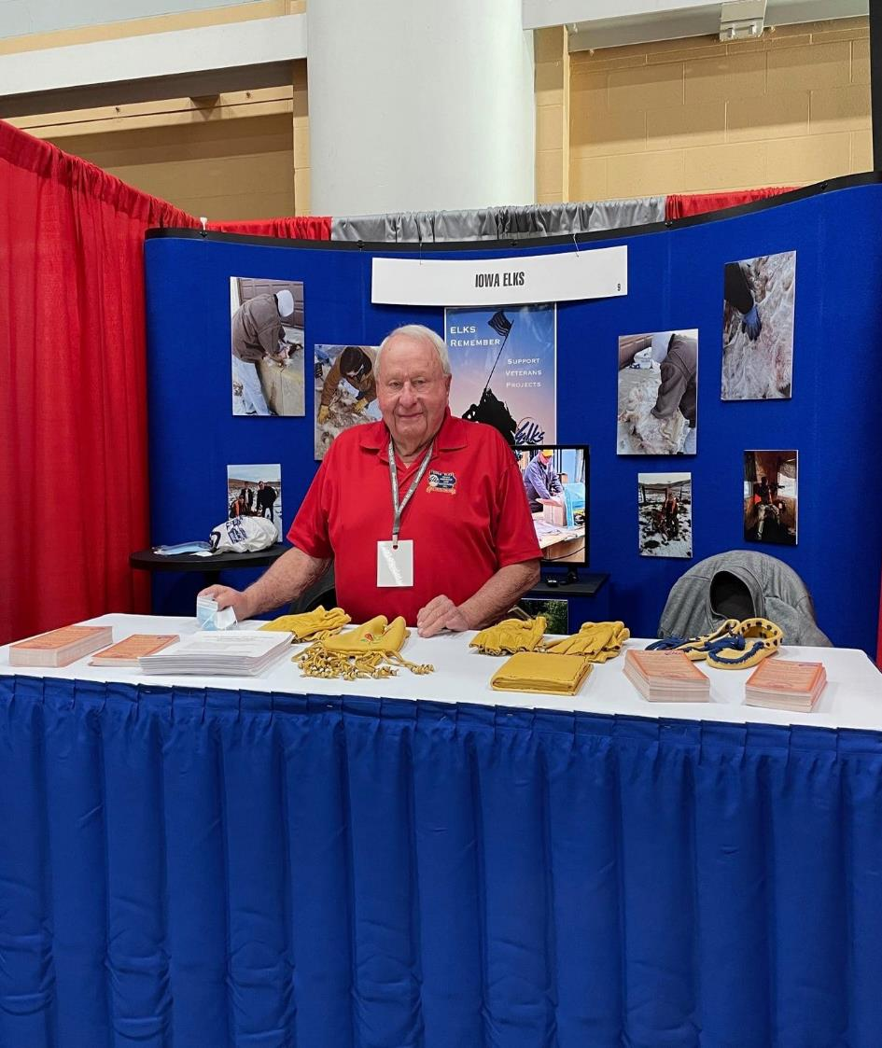
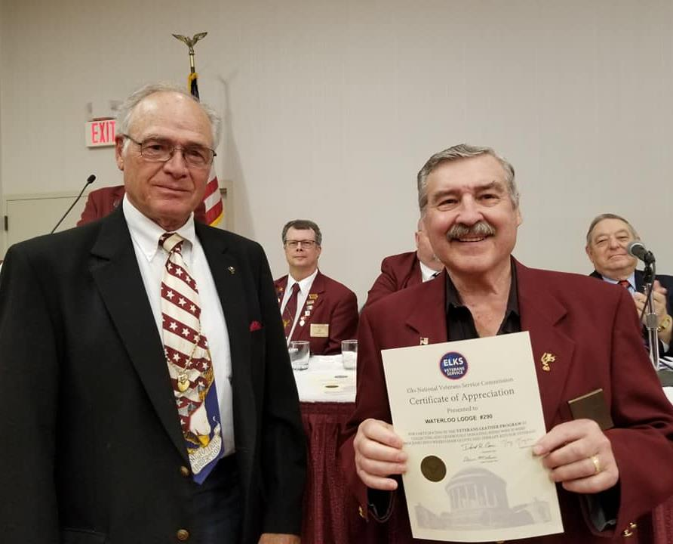
Celebrating Volunteers and Spreading the Word

Slide 4
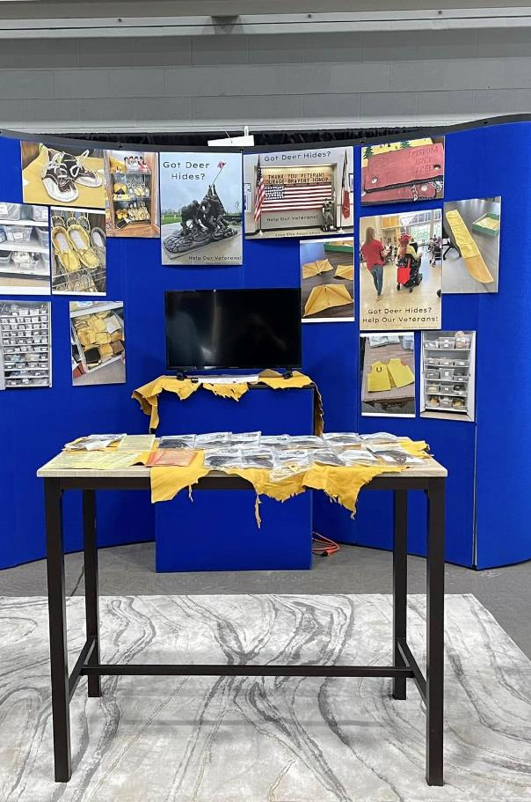
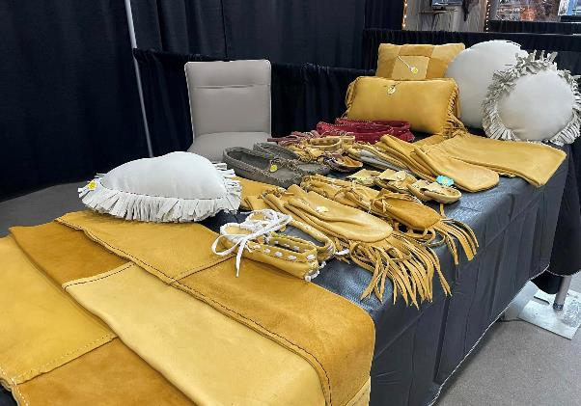
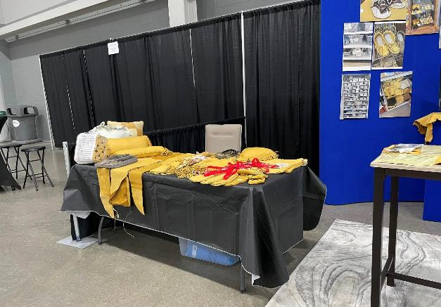
Deer Classic: Something we do in Iowa

Slide 5
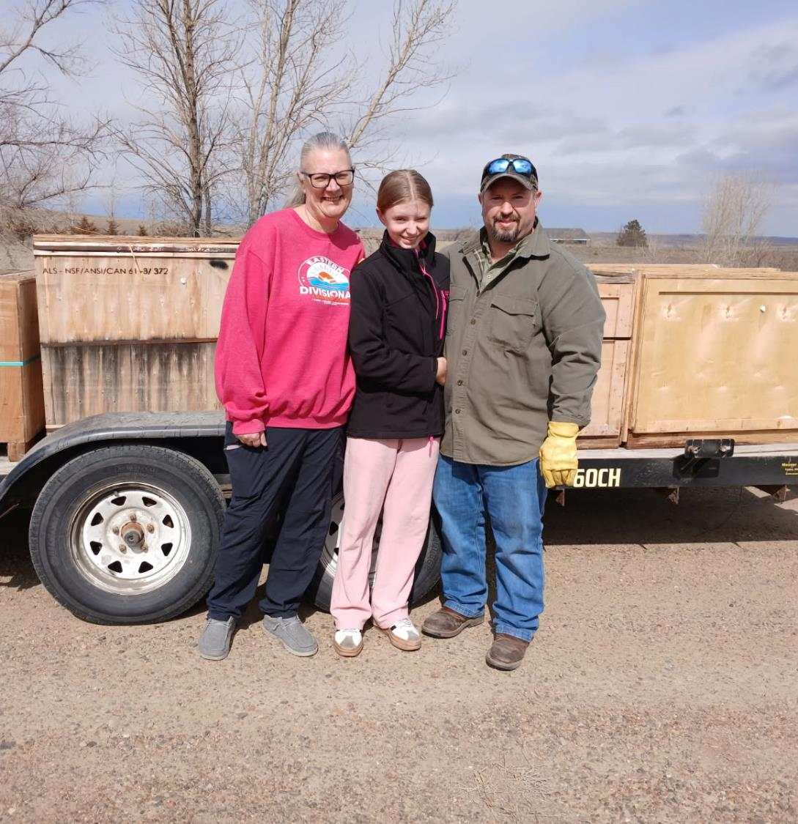
District Chair
Assist the State Chair.
Facilitate communication between all the lodges in the District.
Arrange collection point for the lodges to drop their hides off once salted and packed.
Report numbers to your State Chair on all Lodges in the District.
Attend meetings at Convention to discuss the program .

Slide 6
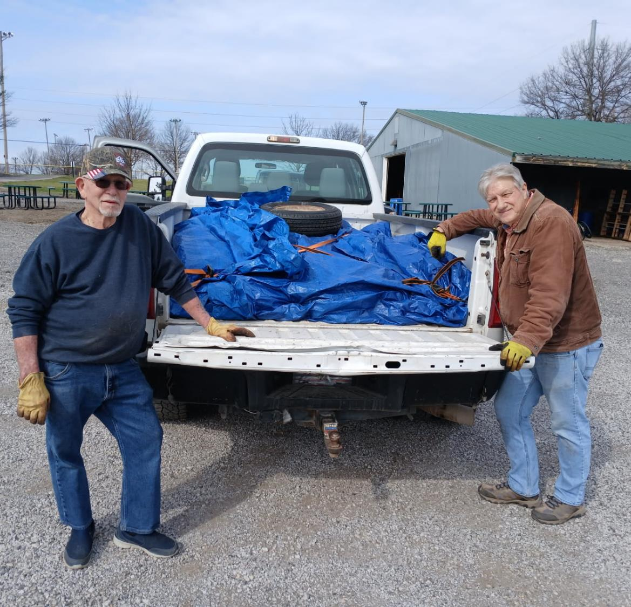
Instructions
Spread the Word – Donated hides come from a variety of locations and individuals such as hunters, farmers, ranchers, slaughter houses, locker plants, taxidermists and highway departments.
It never hurts to ask! This program wouldn’t exist without donations.
Set up collection point(s).
Have a location to prepare the hides.

Slide 7
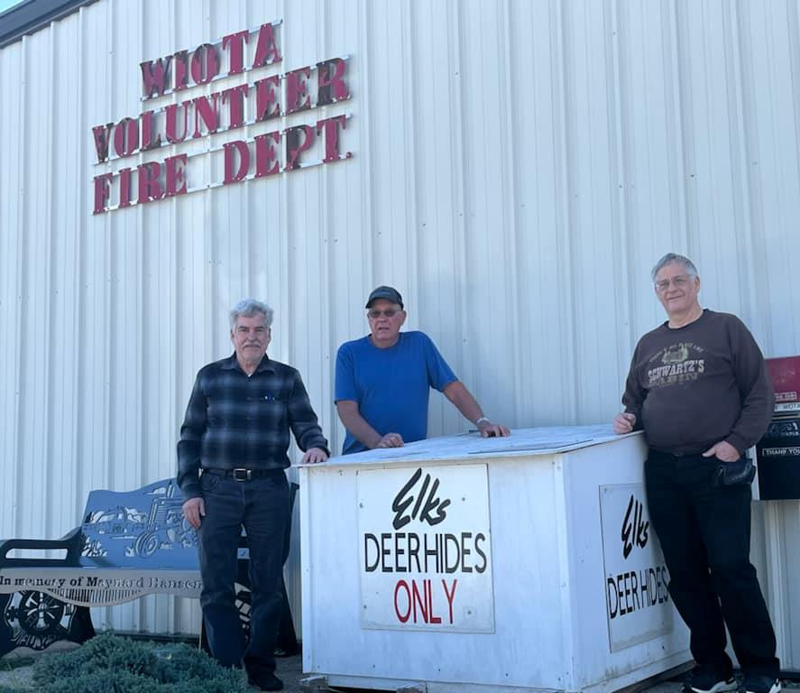
Collecting Hides
Set up drop off locations and check them regularly.
Examine the hides to make sure they are good and not rotten.
Hair test: gently tug the hair it should not fall out easily.
Odor: look for extremely bad smells
Color: check for green/gray discoloration

Slide 8
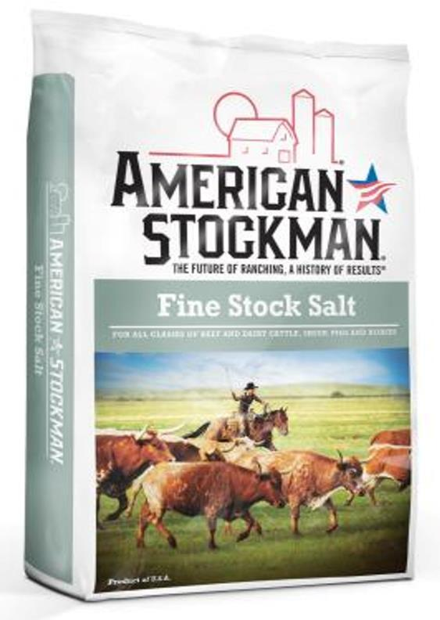
Preparing the hides
Trim the hides.
Salt the hides.
You cannot use too much salt!
Cover the whole surface area.
Fold or roll your hides to keep the salt contained inside.
Place in pallet box.

Slide 9
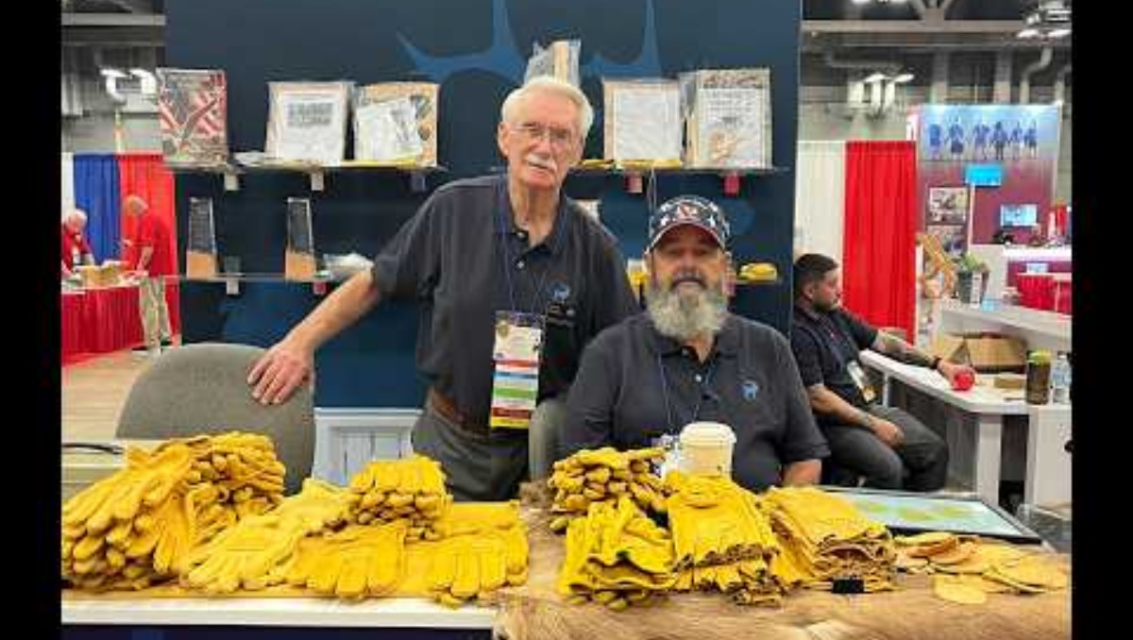
Trimming the hides

Slide 10
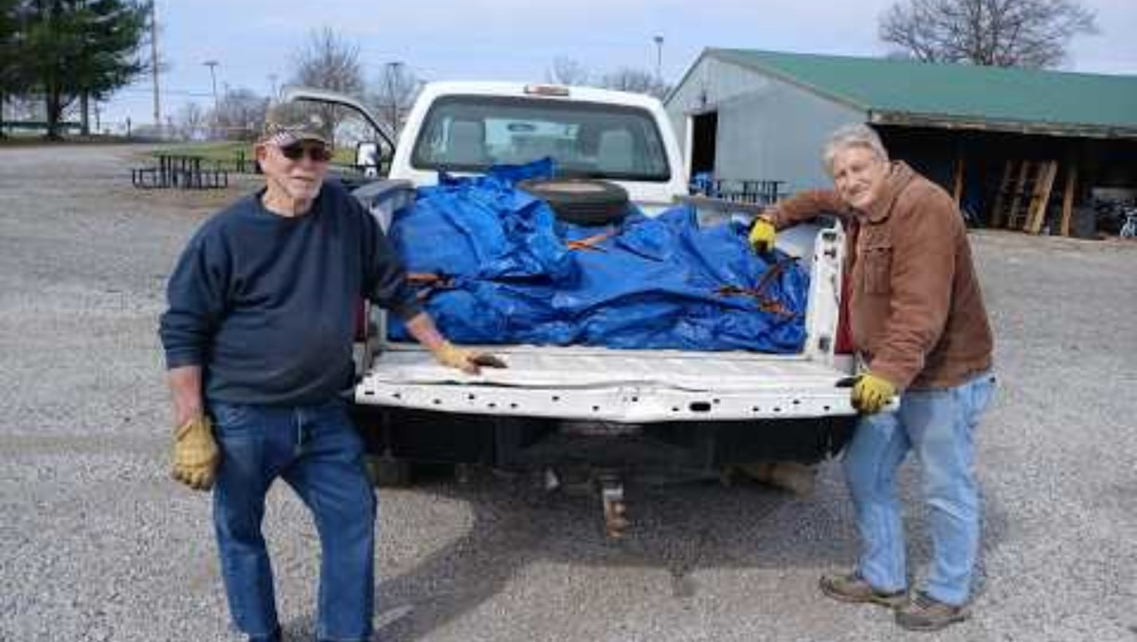
Salting the Hides

Slide 11
Packing Hides
Keep hides level
Do not overload
Shrink wrap if available
Store in a dry cool place preferably not outside
  Hides will drain once packed and salted
Transport to your collection point

Slide 12
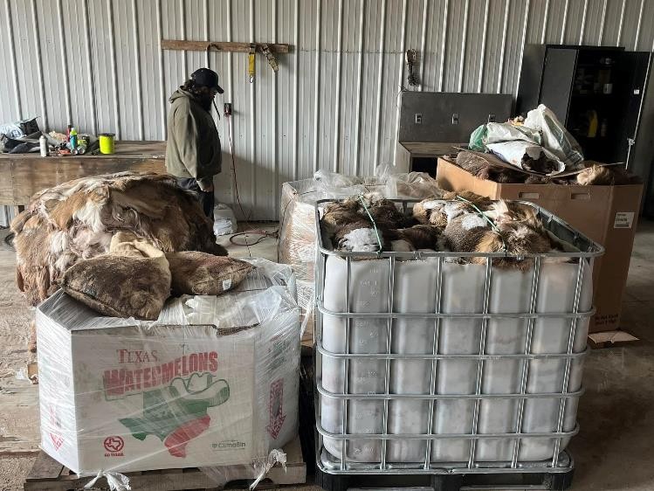

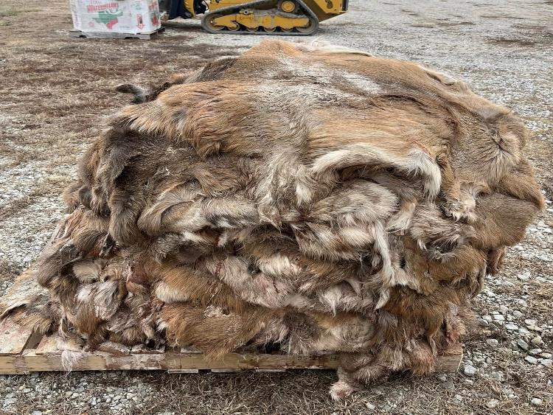


Slide 13
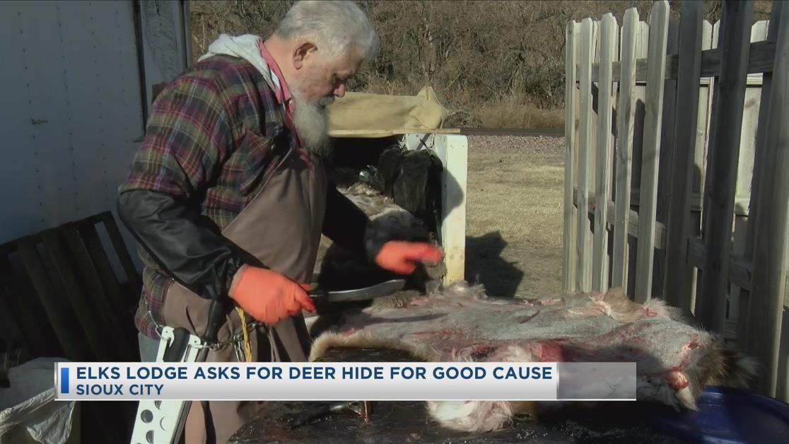
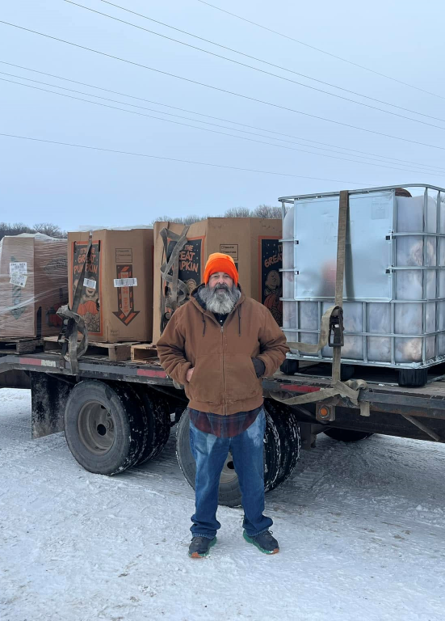
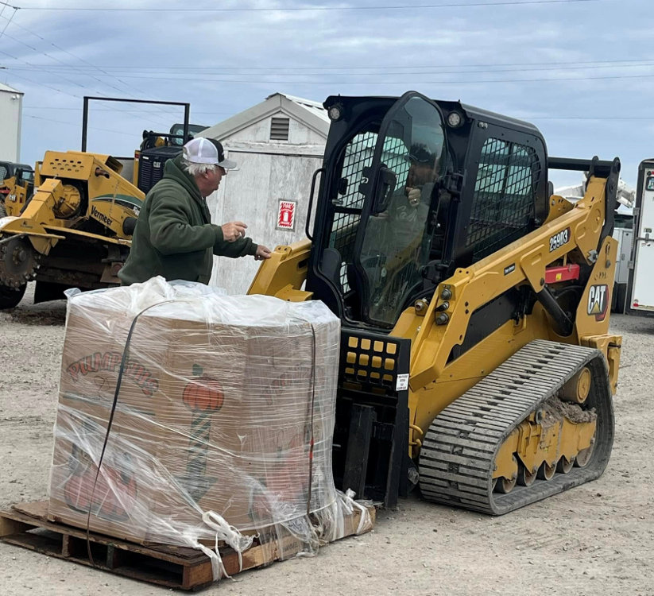
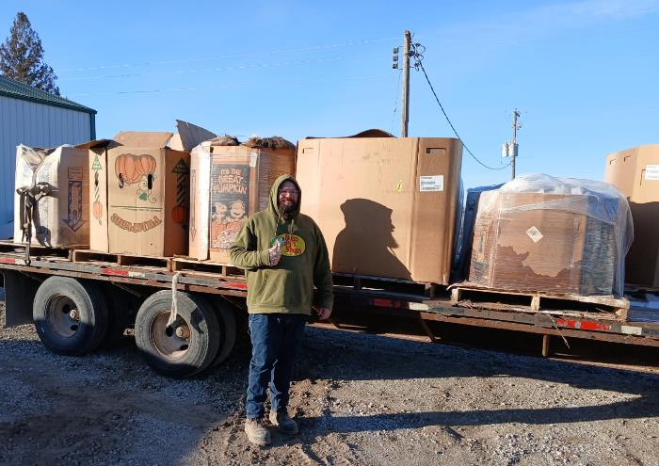
Thank
You!

