Slide 1
Elks Veterans Leather Program
Curtis Blystone

Slide 2
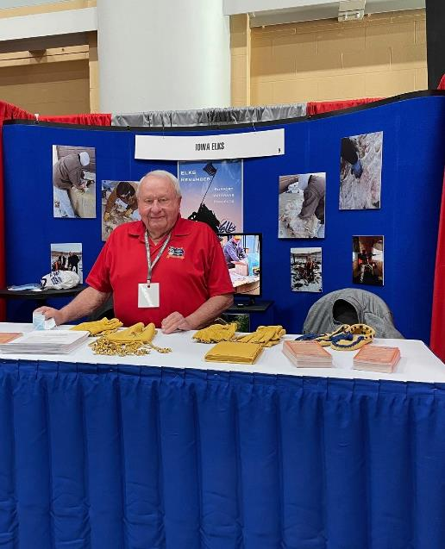
State Leather Chair
The State Leather Chair works with Lodges to collect salted hides that have been prepared for processing.
They coordinate the most cost-effective way to transport these hides to the tanneries.
(If you need a semi to pick them up contact Chuck or myself)
They collaborate with the Director of the National Veterans Service Commission and other Vice-Chairmen.
They work to ensure the smooth and efficient operation of the Veterans Leather Program.
Run meetings at state conventions.
Order certificates for Lodges that participate.
The State Leather Chair is a crucial link in the process of providing support to veterans through the Elks' Veterans Leather Program.

Slide 3
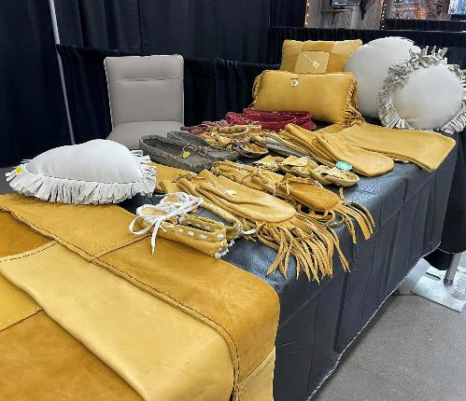
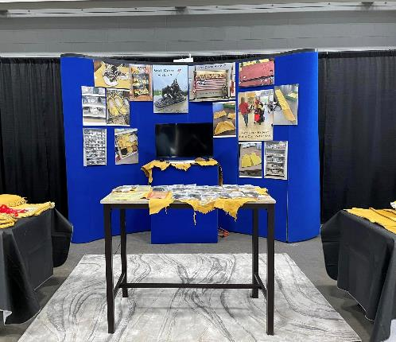
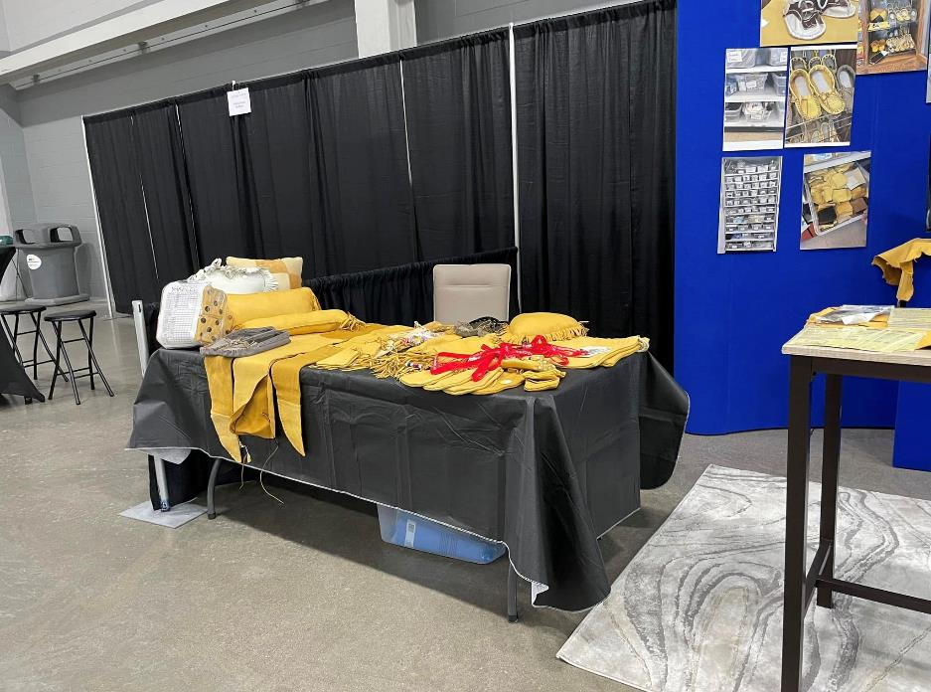
Deer Classic (something we do in Iowa)

Slide 4
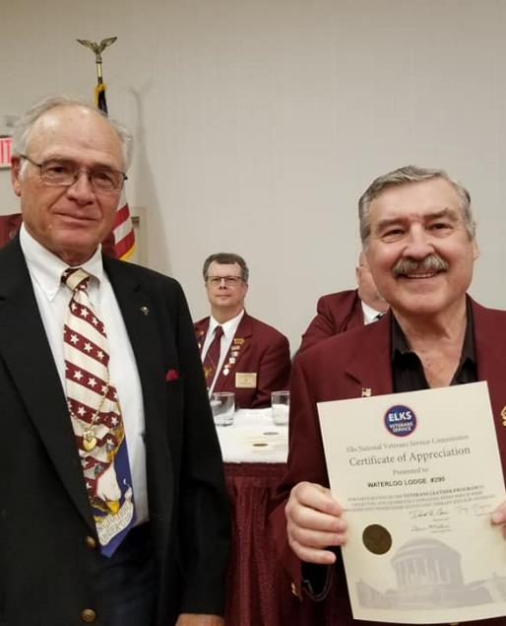
District Chair
Assist the State Chair
Communication between all the lodges in your district
Collection point for the lodges to drop their hides off once salted and packed
Report numbers to your state chair on all lodges in your district
Attend meetings at convention
to discuss the program

Slide 5
Instructions
Spread the Word – Donated hides come from a variety of locations and individuals
such as hunters, farmers, ranchers, slaughter houses, locker plants, taxidermists and highway departments. It never hurts to ask! This program wouldn’t exist without donations.
Set up collection point(s)
Have a location to prepare the hides

Slide 6
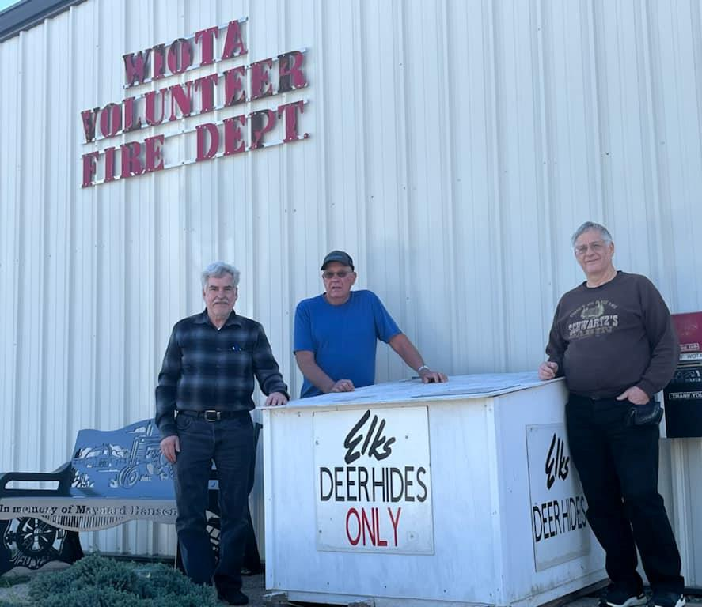
Collecting the hides
Set up drop off locations/ check them regularly
Examine the hides to make sure they are good and not rotten
Hair test- gently tug the hair it should not fall out easily
Odor- extremely bad smells
Color- look for green/gray discoloration

Slide 7
Preparing the hides
Salt the hides
You cannot use too much salt
Cover the whole surface area
Fold or roll your hides to keep the saltc contained inside
Place in pallet box

Slide 9
Packing Hides
Keep hides level
Do not overload
Shrink wrap if available
Store in a dry cool place preferably not outside (hides will drain once packed and salted)
Transport to your collection point

Slide 10
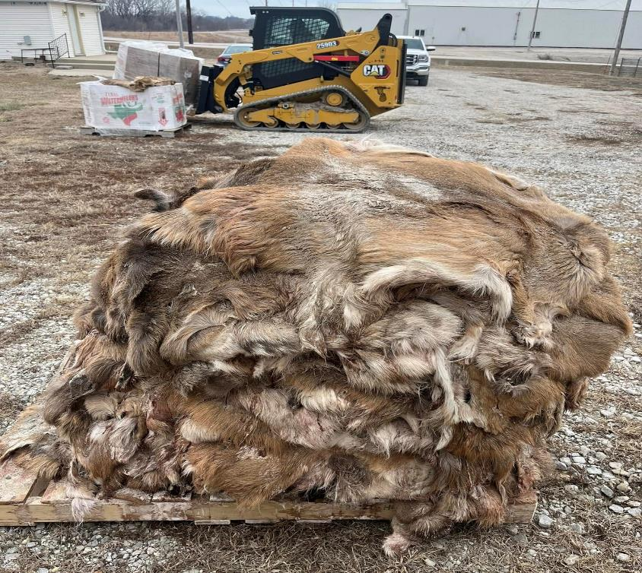

Slide 11
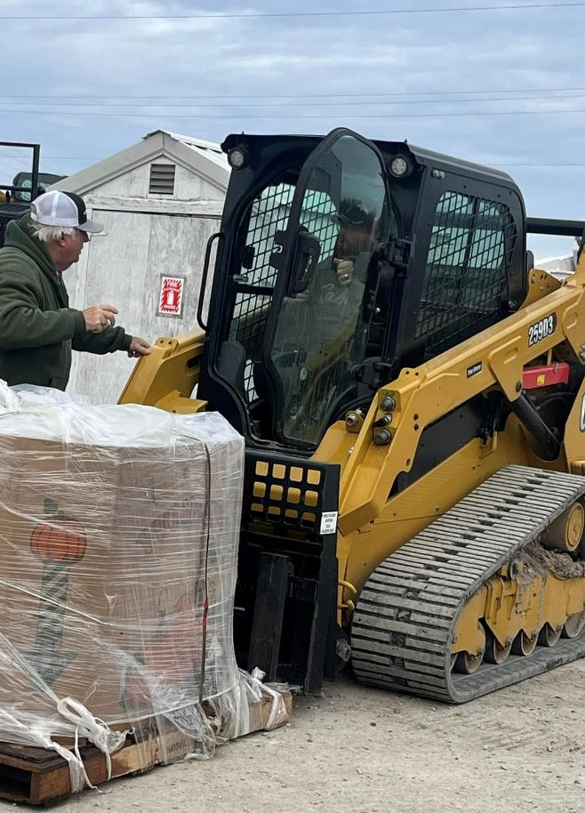
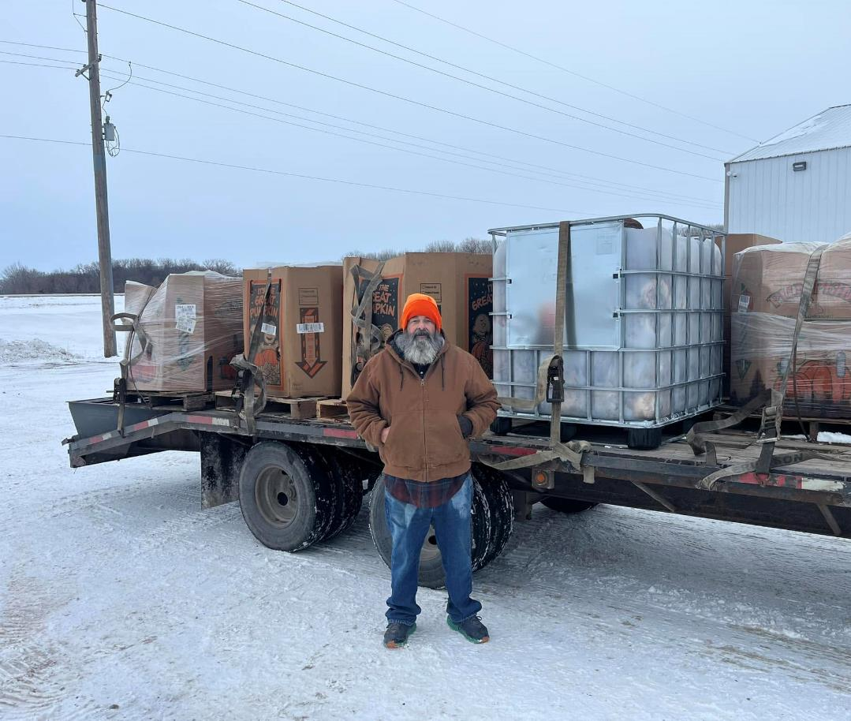

Slide 12
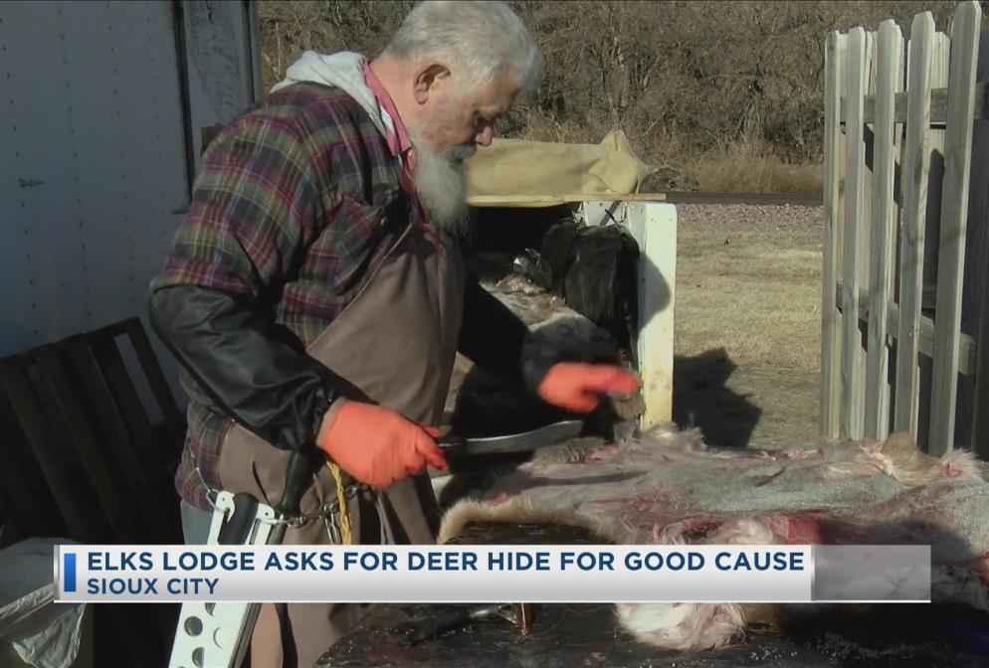
Thank You!

