Slide 1
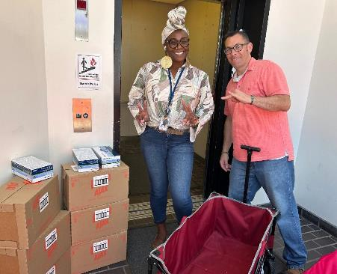
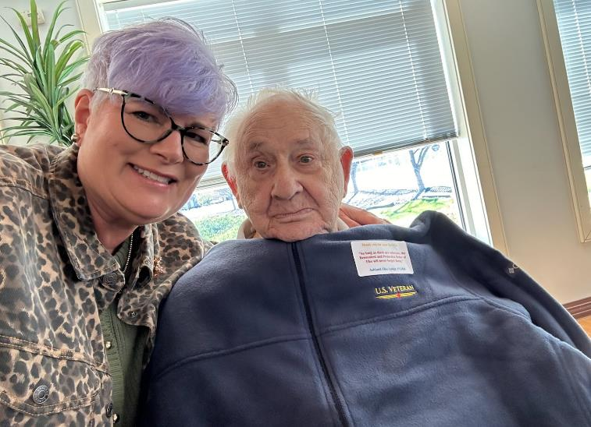
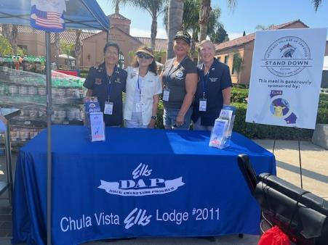
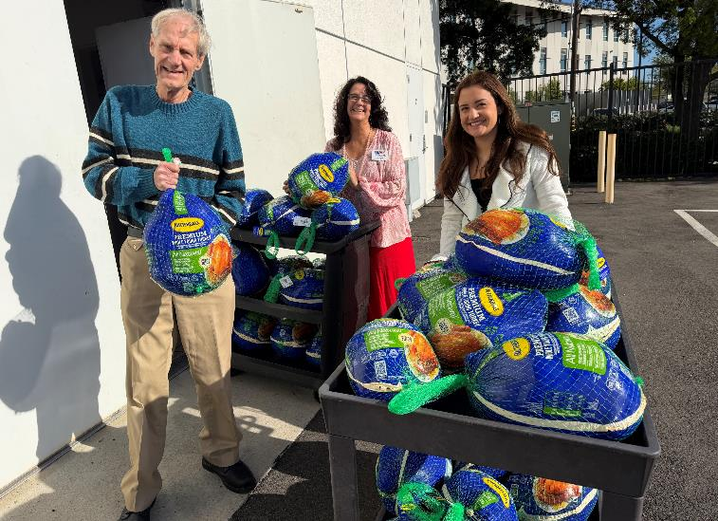

ENVSC 101
Serving Our Nation’s Veterans

Slide 2
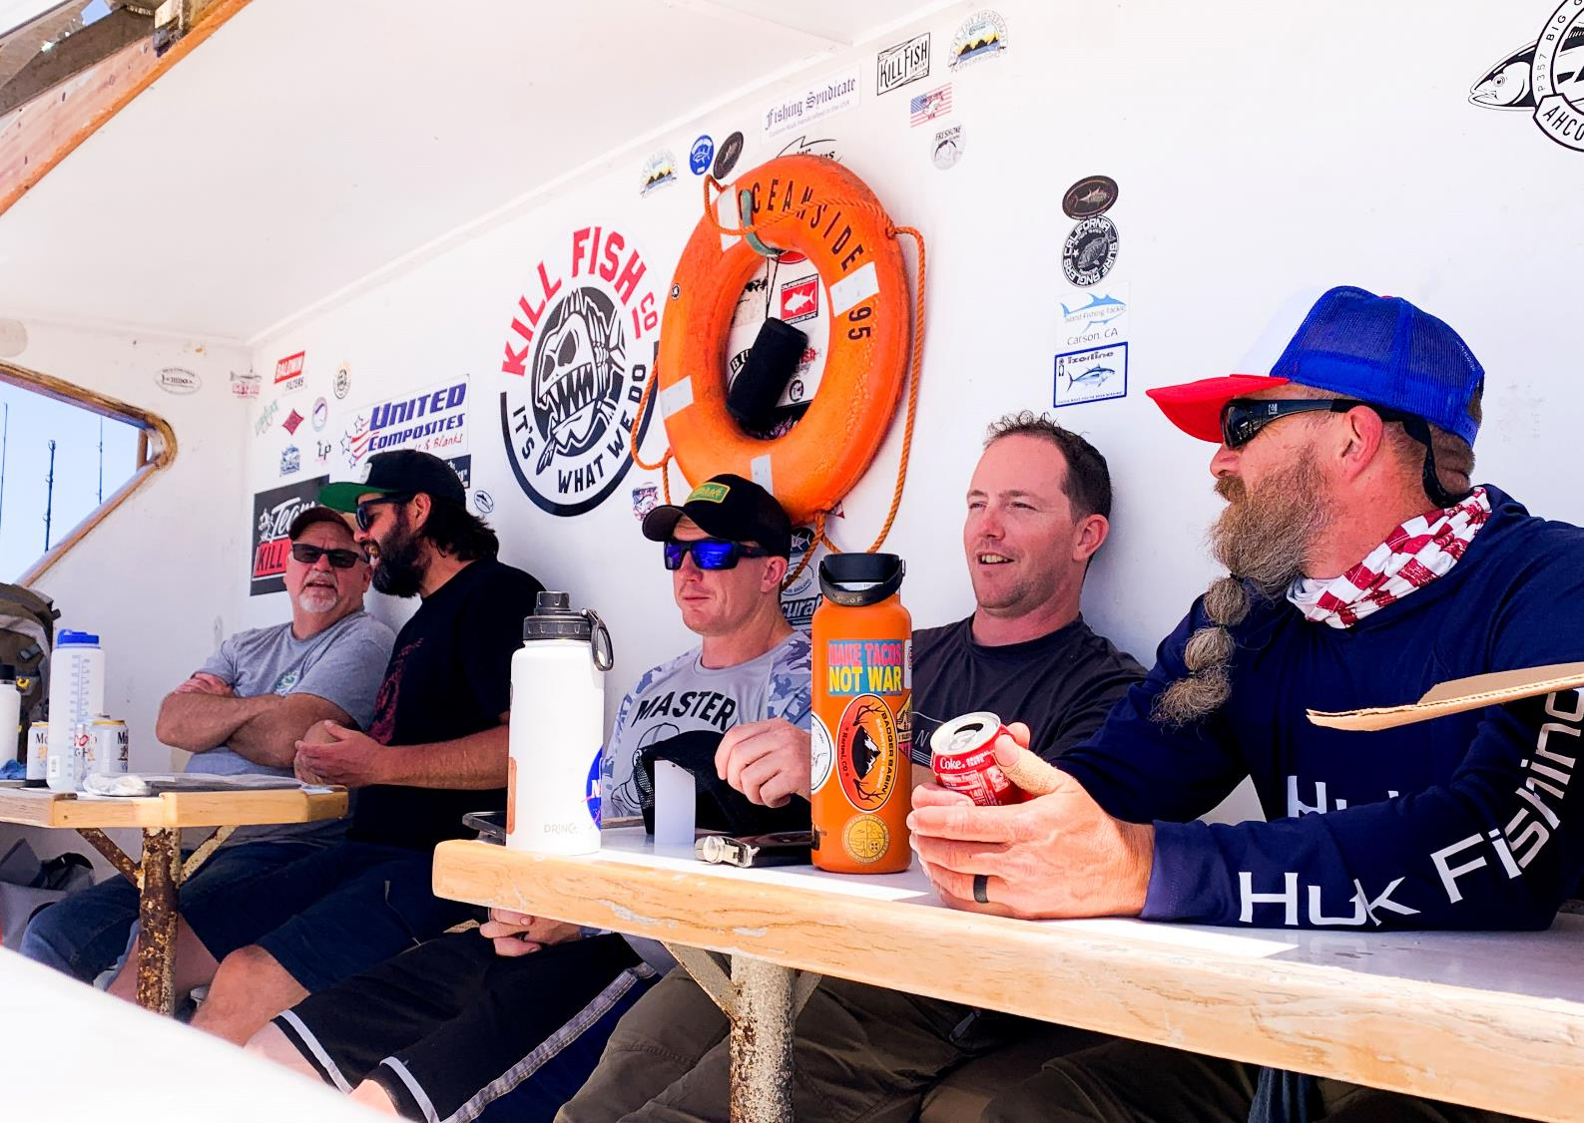
Our Mission
Our mission is to ensure that veterans thrive by providing Elks volunteers with tools and resources through community service and engagement.
We know our members are busy. The purpose of the ENVSC is to provide Elks with the resources and the information needed to best serve the veterans in Elks communities.
To make the most our resources and your time, we aim to focus on serving veterans in need.
Our ultimate vision is a nation of strong communities meeting veterans' ever-changing needs.

Slide 3
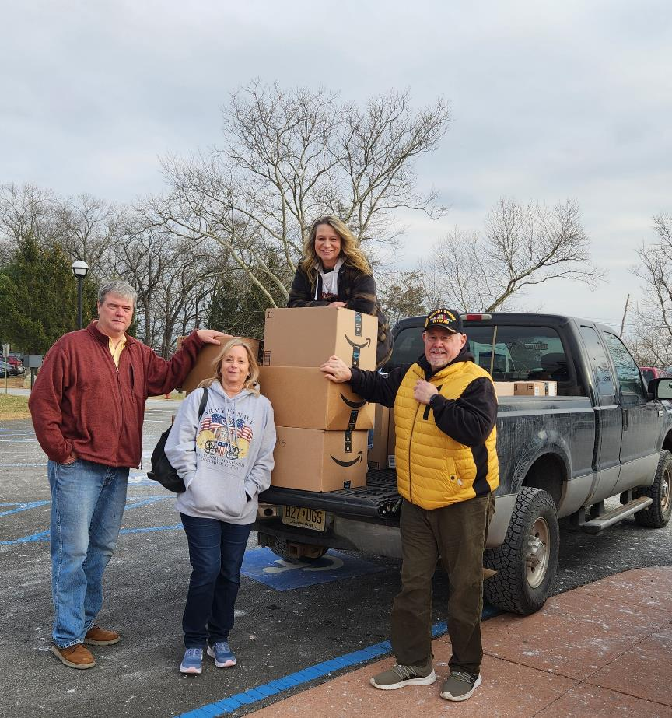
General Guidelines
If Lodges are using ENVSC funds to serve veterans and military members in need, the project must focus on one of these five areas of increased need. These are broad areas and are designed to guide not restrict.
Employment
Homelessness and Housing
Military Families
Health (including mental health)
Educational Support
Why these 5 areas? Research by the VA, the Department of Defense, Blue Star Families, IAVA, VFW and other VSOs show that statistically these are the 5 areas that veterans and military members need and request the most help with. Because there are so many veterans in need, we want to focus our time and effort where it can have the biggest impact.
Notes:
Good intentions are not enough. Be practical, considerate and well informed.

Slide 4
This is a snapshot of our largest programs by budget. Sponsorships includes support of several National Adaptive Sports Events for Veterans, as well as programs like Bugles Across America and Playing Cards for Veterans. We also have several programs and partnerships which do not receive national funding, including Adopt-a-Veteran and Army of Hope.
2026-27 Program Overview

Slide 5
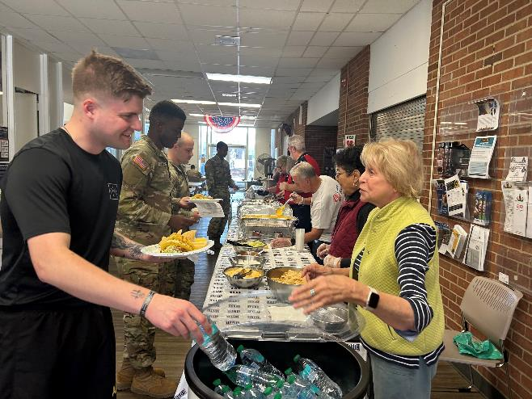
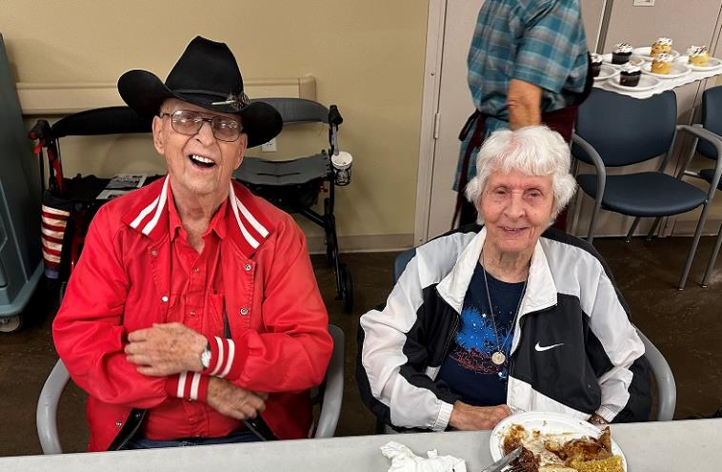
Elks Voluntary Service
The cornerstone of the ENVSC, this facility-based volunteer program is aimed at providing reliable and consistent support to hospitalized and recovering veterans.
We station Voluntary Service Representatives and Deputy Representatives at veterans’ facilities and provide them with monthly stipends to help fund activities and support for veterans at their facility.
Volunteers are required to be certified by the national ENVSC office and undergo training and registration at their local facility.
Thanks to the large number of Elks volunteers in VA facilities, the Elks are on the Executive Committee for the national VAVS program.
The Elks Voluntary Service Program expanded upon the VA’s idea and stations volunteers at State Veterans Homes and community veterans’ facilities as well.

Slide 6
Elks Voluntary Service Facilities
Program volunteers provide valuable social support for thousands of aging and hospitalized veterans, improving their lives and their health.
Representatives visit their facilities at least once a month to spend time with veterans. They plan events, recruit volunteers, handle the monthly stipend and submit monthly online reports to the ENVSC.
Deputy Representatives provide additional support to the veterans, assist the Rep and fill in as needed.
About 70% of Elks Representatives serve in VA Medical Centers or State Veterans Homes.

Slide 7
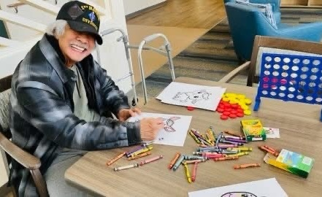
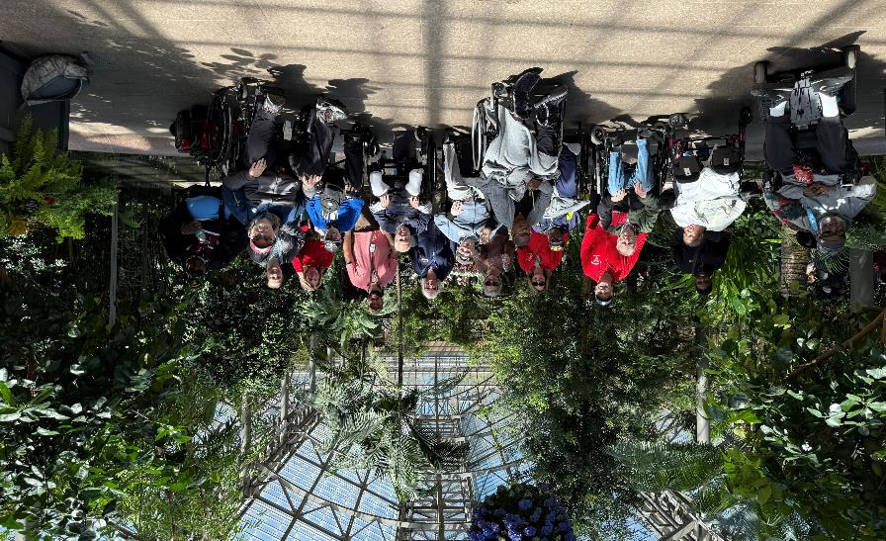
Elks Representatives in Action!
David Perry regularly hosts outings and activities for veterans at the South Orange County Vet Center in Mission Viejo, including deep sea fishing, clam digs, and hunting trips.
John Phelan takes veterans from the Hot Springs VA on a monthly trip to Crazy Horse Memorial and breakfast at Laughing Water restaurant, where they spend time and make memories together.
Randall Dugan and other Elks volunteers participate in the Arkansas Veterans Coalition, combining forces to help meet veteran needs across the state. Randall also provides supplies and plans events for veterans at the Mena VA CBOC.
Patrisia Miller hosts bingo and meals every month for residents at the Georgia War Veterans Home in Augusta, along with her Deputy Connie Magriplis.

Slide 8
Freedom Grants
In 2026-27, the Elks National Veterans Service Commission will award Freedom Grants to 1,000 Lodges! All Lodges are eligible to apply. This is a great way for Lodges everywhere to plan a project that meets the needs of local veterans.
Here are some guidelines to keep in mind.
Take the time to plan an impactful project. Applications are reviewed and approved on a rolling
basis over months so there’s no need to rush.
Projects must serve at least 4 veterans in need, to maximize outcomes.
Think local! General donations to state and national organizations don’t qualify.
Here are some common questions.
Monetary donations qualify if made to nonprofit organizations that specifically serve veterans in need.
Donations to member organizations like the VFW and the American Legion must be designated for a specific project that serves veterans in need. Funds can’t go toward general operations.
Grants should be focused on meeting veterans' urgent needs, so appreciation dinners open to all veterans, like a community Veterans Day dinner, do not qualify. Similarly, memorial projects don't qualify.

Slide 9
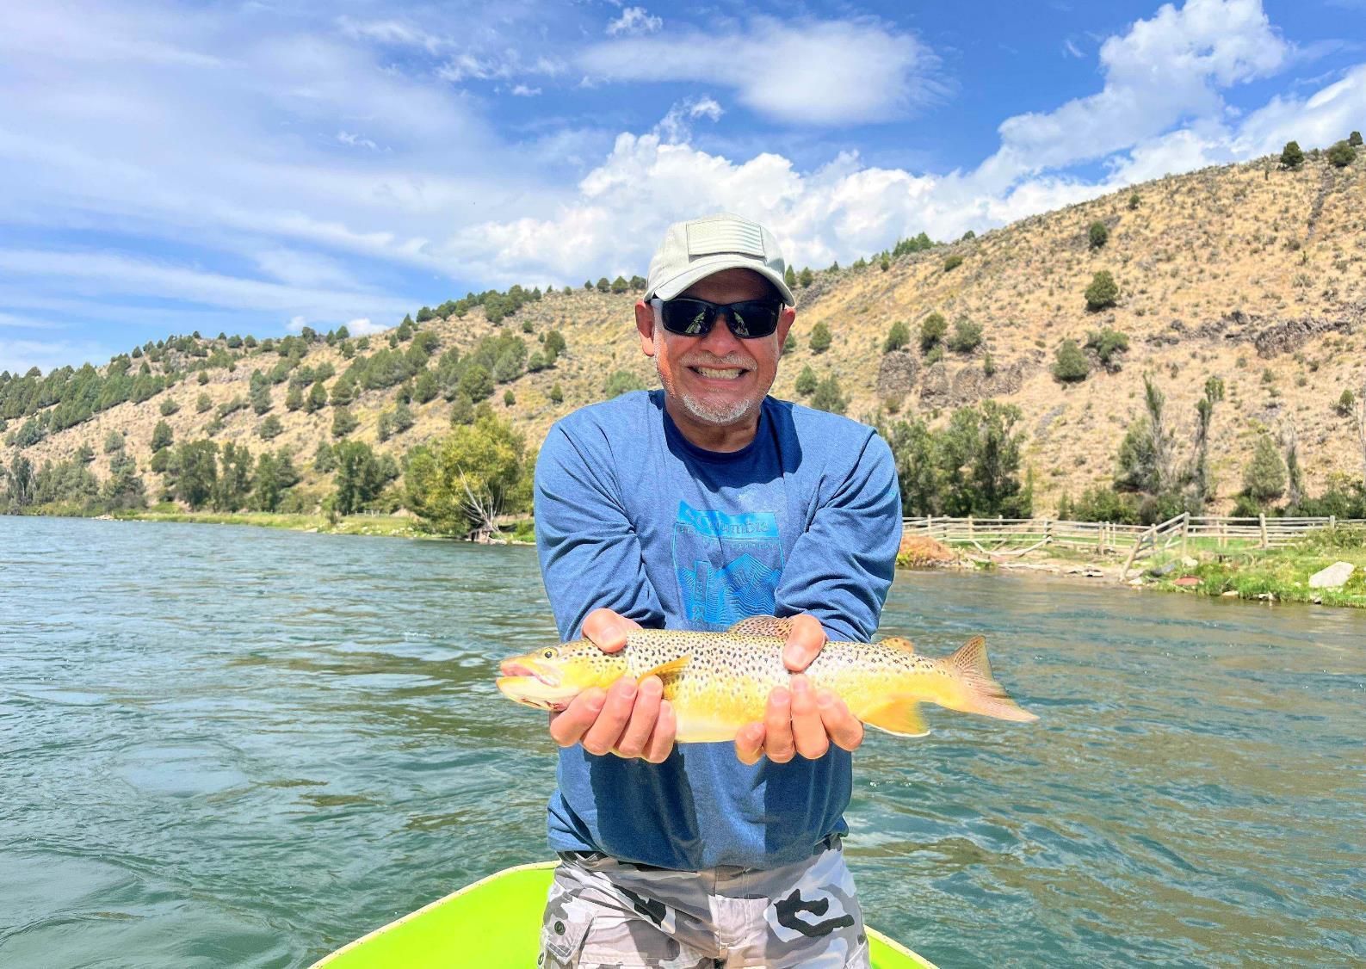
Successful Freedom Grant Projects
Salem, Ill., Lodge No. 1678 purchased soups, canned meat, pasta, and more for the Marion VA food pantry. Elks served 100 veterans with the food and were inspired to start an ongoing food drive at the Lodge.
Clovis, Calif. Lodge No. 2599 packed Survival Backpacks filled with gloves, homemade knit hats, hand warmers, and other winter items. Elks distributed the bags to veterans at the Stand Down.
Summerville, S.C. Lodge No. 2719 provided a Christmas brunch to residents of Veteran’s Victory House, complete with holiday treats, music provided by the Navy Choir, and a visit from Santa and his elves offering personalized gifts.

Slide 10
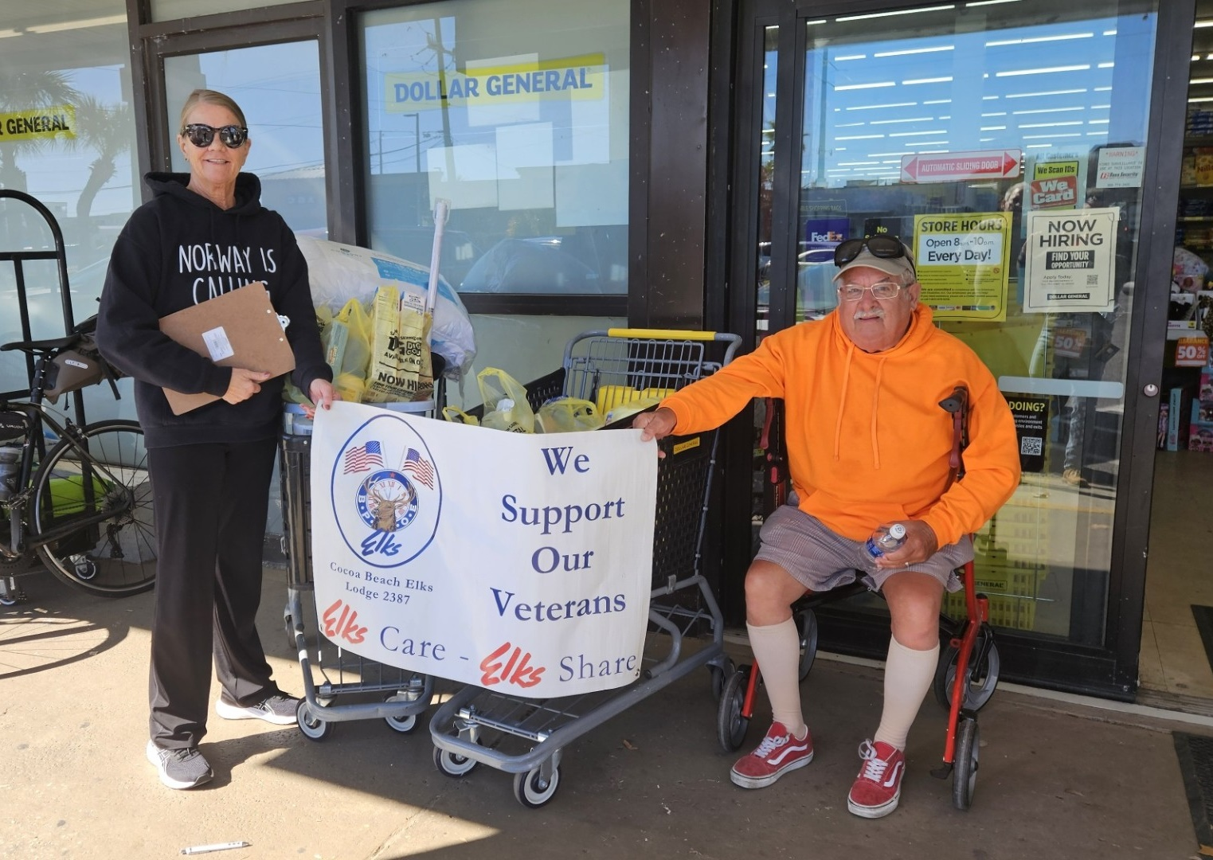
Welcome Home Kits
Most formerly homeless veterans move into new homes with nothing. Elks can help! Here’s how to get started.
Find out what the veteran needs. Start with a standard list of what a new home would need, and then tailor the kit to the needs and preferences of the veteran.
Shop for the items. Look for deals. Ask Lodge members if they have items to donate. Hold a supply drive to collect common items.
Assemble and deliver the kit! Deliver the kit to the veteran or project partner. Stay in touch with the veteran if you can.
Submit your receipts to the ENVSC online. The ENVSC will reimburse your Lodge up to $400 for each Welcome Home Kit you provide, and up to $600 for each kit that also includes a bed.

Slide 11
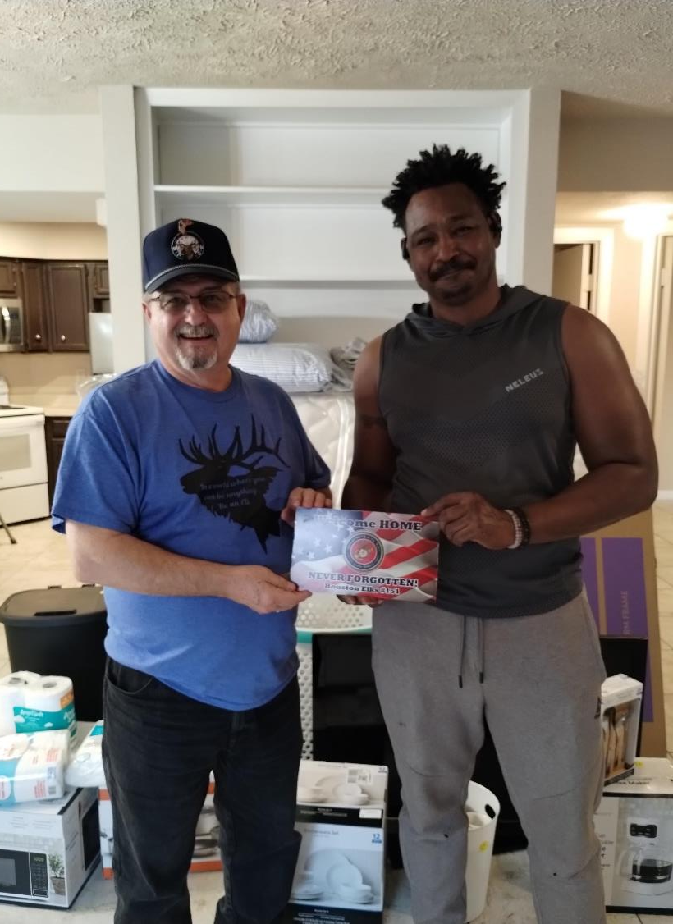
Welcome Home Kit FAQs and Tips
A kit must include a variety of items. It may not include just one of two items.
Kits are intended exclusively for veterans exiting homelessness and moving into new homes.
Gift cards may not comprise more than $25 of any kit. Food may not comprise more than $50 of any kit.
We recommend that beds do not comprise more than $500 of any kit.
If your Lodge can only do a kit every few months that is fine. This isn’t a numbers race; it is about helping veterans whenever we can.

Slide 12
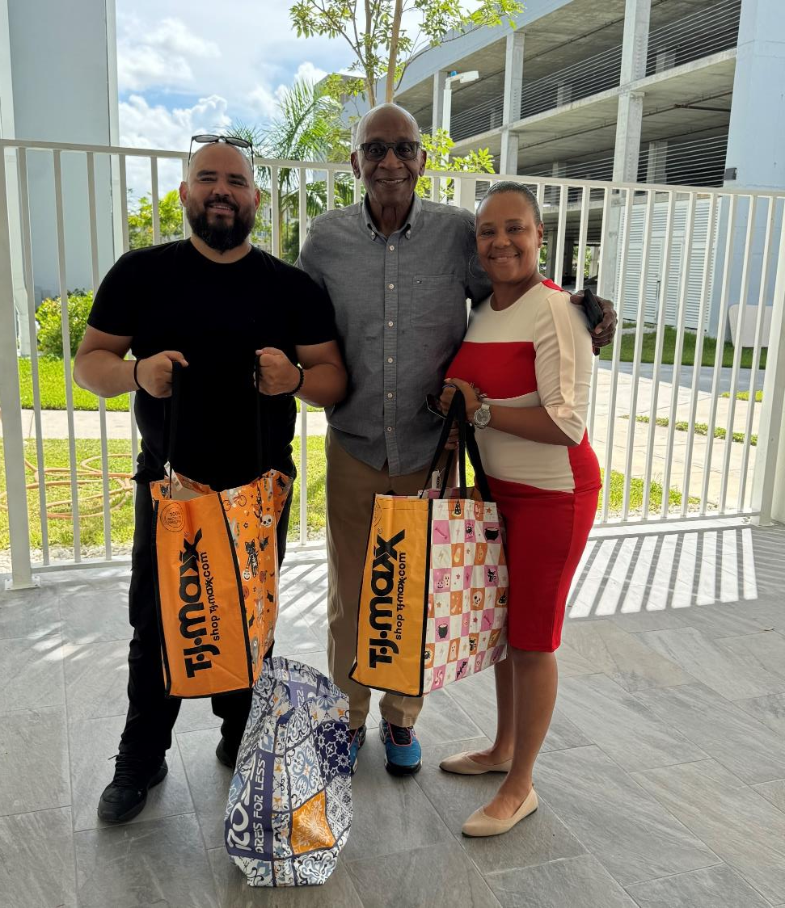
Focus Grants
Lodges in the 13 metropolitan areas with the highest number of unhoused veterans are eligible for additional Focus Grant funding of up to $10,000 for large-scale, Elks-run, direct service projects. Applications are available online April 1.
Here are some examples:
Food baskets and monthly dinners for newly housed veterans.
Supplies, a dental care van, and volunteer support at a Stand Down.
Partnership with AmVets or a nonprofit thrift store to provide beds and bedding supplies for veterans moving into homes throughout the year
Monthly cooking workshops, meals, and support at a veterans housing facility.

Slide 13
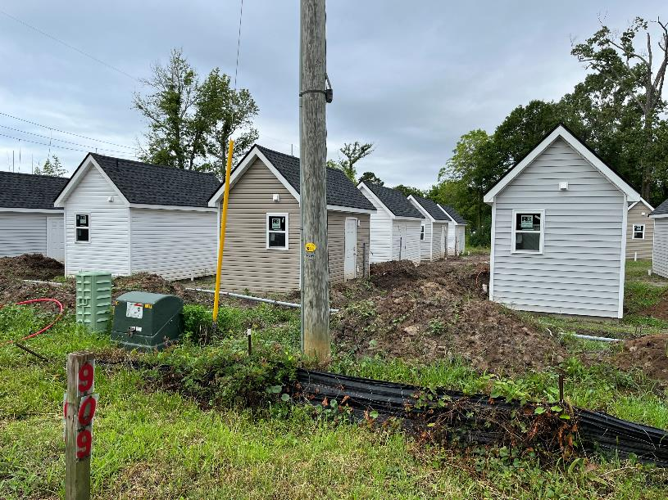
Elks Emergency Assistance Fund
Run out of the ENVSC office in Chicago, this program provides emergency financial assistance directly to veterans to help them exit or prevent homelessness.
Veterans registered with and receiving services from the Department of Veterans Affairs in the 13 areas* with the highest number of homeless veterans can apply for one-time monetary assistance to prevent homelessness or secure a home.
Uses include rent, security deposits, and utilities.
Veterans must be referred by a VA social worker; application forms must be signed by the veteran and by a VA employee.
A study from the University of Notre Dame says that “people who received financial assistance ‘are 76 percent less likely to enter a shelter within six months. . . And significantly less likely to become homeless.’ Not only do targeted prevention programs work, they also can save the community money.”

Slide 14
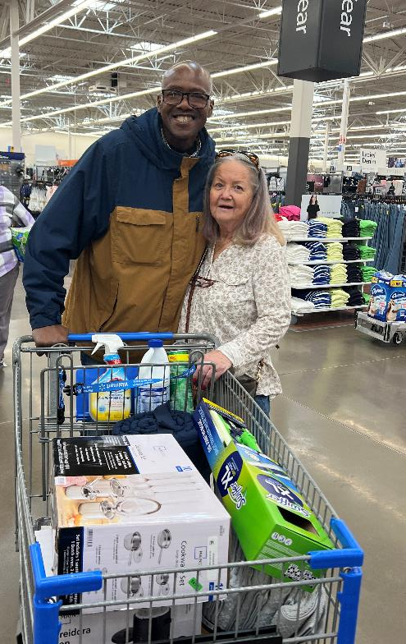
Emergency Assistance Fund in Action
This is an invaluable service for veterans working to save or gain housing. Thanks to this fund, veterans from all walks of life are safely housed.
A Korean War veteran turned to the Elks for help when the rent at his longtime apartment was raised and his benefits no longer covered costs. We paid a security deposit so he could move to an affordable place for the long haul.
A veteran who’d been the victim of identity theft turned to the Elks to pay her rent while she sorted through months of paperwork and financial complications.
A veteran lost his job after months of being hospitalized and turned to the Elks for help ensuring his apartment would still be there when he recovered.
An OEF veteran sought our help after gaining custody of his 2 children, so he could afford rent and a security deposit for a home large enough for all of them.
Once housed, the Elks also provided this veteran with a Welcome Home Kit!

Slide 15
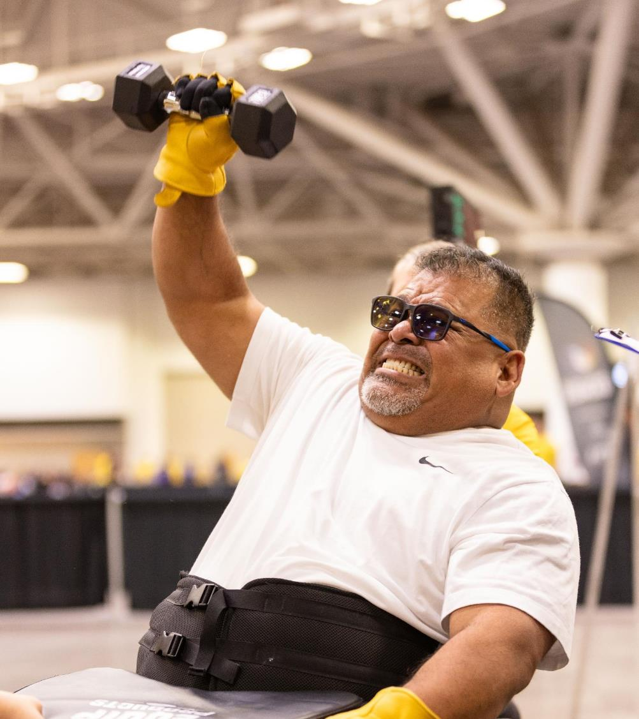
Veterans Leather Program
The Veterans Leather Program relies on the charity of hunters across the nation to donate hides.
Elks and hunters donate hides which are tanned and finished into leather to be used for wheelchair gloves and therapy kits for veterans.
Elks donated 8,425 hides in 2024-25!
Representatives can order gloves and craft kits for veterans they serve.
Lodge Veterans Chairs can order craft kits for veterans they serve, free of charge, thanks to the Elks leather donations to Help Heal Veterans (HHV).
All forms available at www.elks.org/vets/leather.cfm.

Slide 16
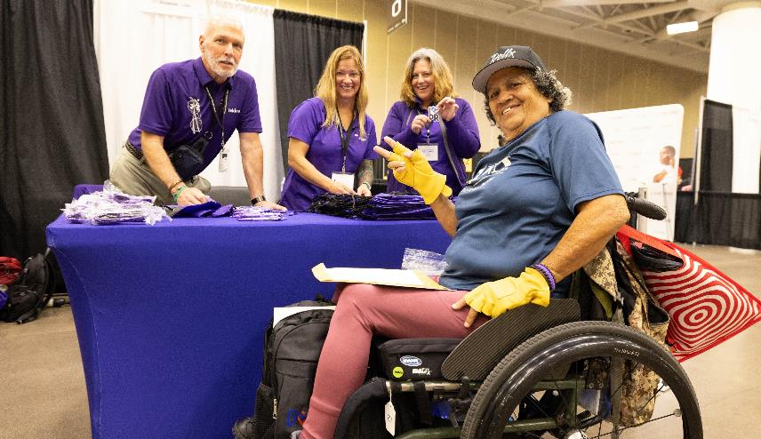
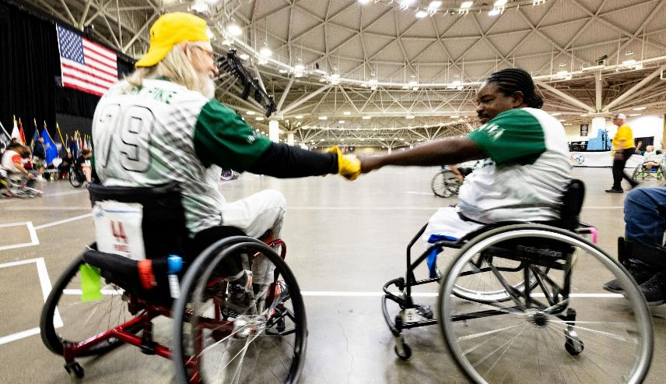
Adaptive Sports Events
Through these events, the VA and other partners offer veterans the chance to improve their health through sports and art, learn new skills and socialize with other veterans.
The ENVSC assists by sponsoring 6 of these events. Local volunteers often volunteer, host dinners and provide their own support.
Leather Program volunteers also attend to distribute gloves, and veterans wear them when they compete!
Sponsored by the ENVSC:
Veterans Winter Sports Clinic
Veterans Wheelchair Games
Veterans Creative Arts Festival
Veterans Golden Age Games
Veterans Summer Sports Clinic

Slide 17
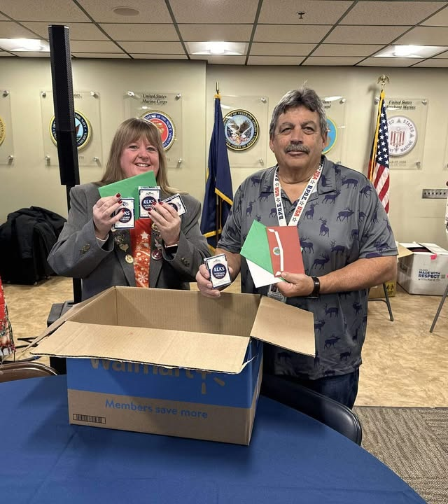
Partnerships & Programs
Bugles Across America
This organization provides veterans and their families with a formal recognition of their service by providing live taps at veterans’ funerals. The ENVSC provides financial support to help recruit, train and organize buglers across the country. Many Elks are volunteers!
Playing Cards for Veterans Program For many veterans in hospitals, VA homes, nursing homes and care centers, time can move slowly between visits from family and friends. Veterans are often looking for ways to stay engaged and upbeat. Playing cards can offer an engaging and social activity to fill spare time. ENVSC volunteers can order playing cards for veterans.
Make the Connection / Veterans Crisis Line These two organizations focus on mental health resources for veterans. Make the Connection is an online resource center. The Veterans Crisis Line (988-1) serves veterans who are at-risk or in need of emergency assistance.

Slide 18
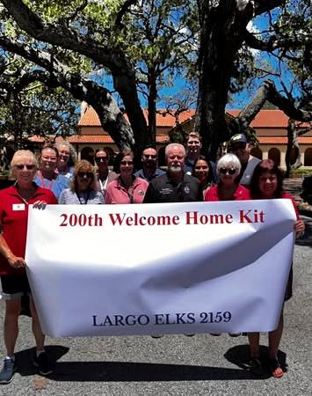
Stay in Touch & Informed
Visit elks.org/vets to learn more.
While there, sign up to get our monthly e-newsletter.
Follow us on Facebook and Instagram.
Connect with your State Veterans Chair and volunteers in your state.
Email Vets@elks.org.
Call the ENVSC at 773-755-4736.

