Slide 1

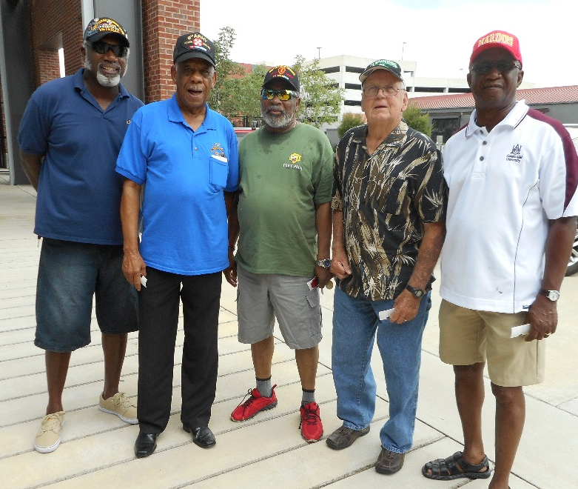
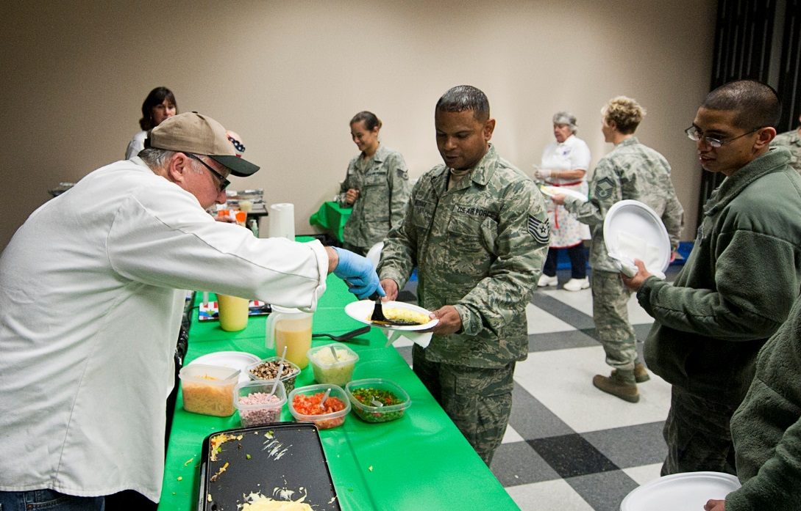
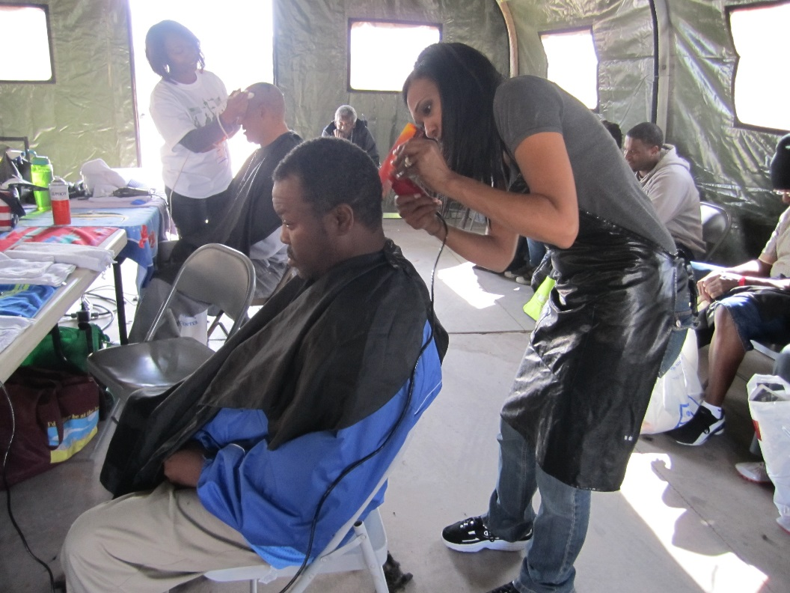
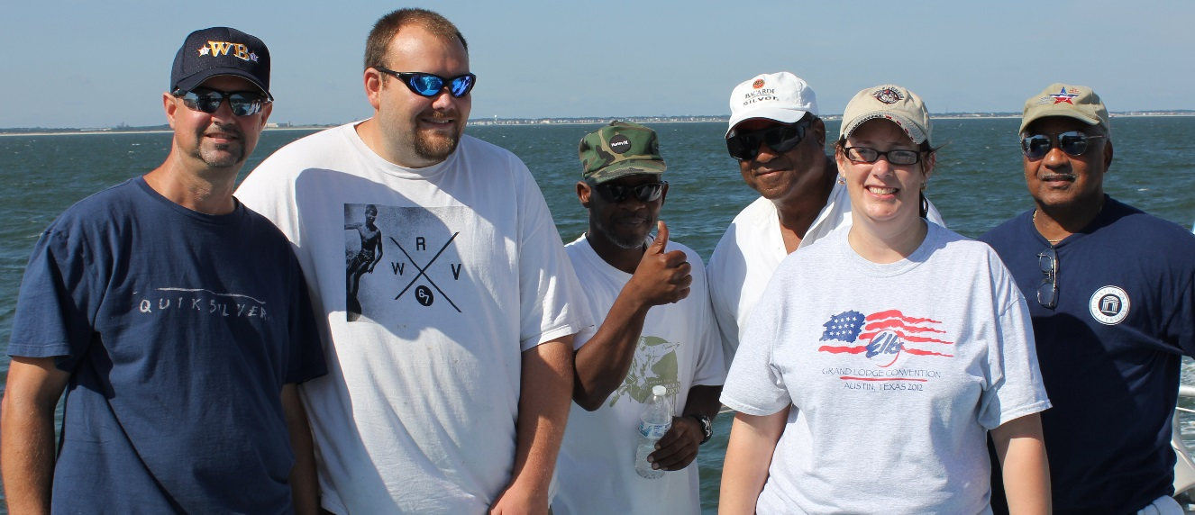
Serving our Nation’s Veterans

Slide 2
Elks National Veterans Service Commission
Ending Veteran Homelessness: How the Elks can Help
Elks National Convention
July 4, 2016

Slide 3
Our Mission
The Elks are committed to the mission, “So long as there are veterans, the Benevolent and Protective Order of Elks will never forget them.”
The Veterans Service Commission takes that pledge one step further, and promises service to our nation's veterans and military members, with a special focus on service to those in need.

Slide 4
ENVSC Programs
National Programs
Freedom Grants
Playing Cards for
Vets
VAVS
Veterans Leather
Program
Adopt-a-Vet
Welcome Home
Partnerships
Re-Creation
Bugles Across
America
VA Adaptive Sports Events
Notes:
Today, we’ll be focusing mostly on the newest program, the Welcome Home program.

Slide 5
The Bad News
There are more than 47,000 veterans experiencing homelessness in the United States on any given night.
Many veterans are chronically homeless and/or have co-occurring health issues and substance abuse problems.
Many veterans who become homeless don’t know they can go to the VA for help.
Fast Facts
As many as 10 percent of homeless adults are veterans.
70 percent of veterans served by the VA have dealt with chronic homelessness and unemployment.
14 percent of veterans served by the VA have families.
Notes:
What we’ve learned this year is that it’s pretty easy to fall into homelessness. Things like health problems or a car breakdown can cause someone to lose their job, and pretty soon they can’t pay their rent or their mortgage.
Chronically homeless means without a home for more than a year, or experienced homelessness 4 times or more during the last 3 years.

Slide 6

The Good News
The VA has made this issue a priority, and provides health care, housing solutions, job training, rent assistance and other supportive services.
They’ve recruited community partners, and raised awareness.
Since many of these changes began in 2010, veteran homelessness has dropped 36%.

Slide 7
But, the VA can’t solve this problem alone.
That’s where the Elks come in!
When the Elks asked the VA how they could do more to serve veterans, the VA asked the Elks to join the fight to end veteran homelessness.
In September 2015, the Elks signed a Memorandum of Agreement with the VA pledging to serve homeless veterans.
“Thank you to Elks across this great country for your generosity and loyalty to our nation’s heroes.”
- Veterans Affairs Secretary Robert McDonald

Slide 8
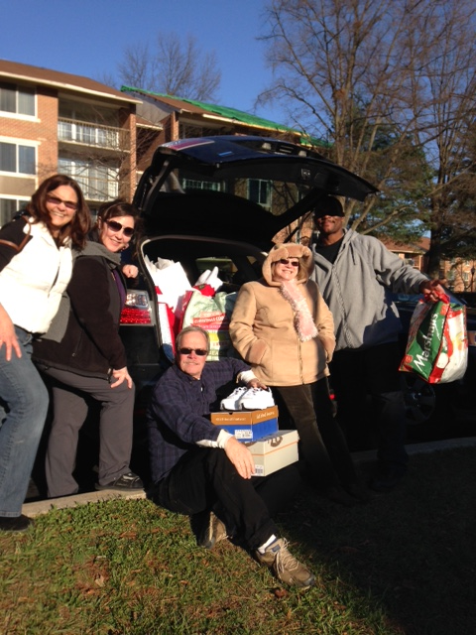
Welcome Home Initiative
The Elks have pledged $4 million over four years to help end veteran homelessness. The program will have five main components.
Awareness Campaign
Elks Housing Navigators
Welcome Home Kits
Elks Emergency Assistance Program
Adopt-a-Veteran

Slide 9
Where to Start
The VA: every VA Medical Center has at least one person on staff whose job is to focus on homeless veterans
Nonprofits: groups like Volunteers of America and the Salvation Army have veterans outreach programs.
Veterans Organizations: independent groups, vets rehabilitation and/or transitional centers.
Cities and counties: many municipalities have Veterans Affairs departments.
Or, contact the ENVSC office and we’ll put you in touch with someone in your area!

Slide 10
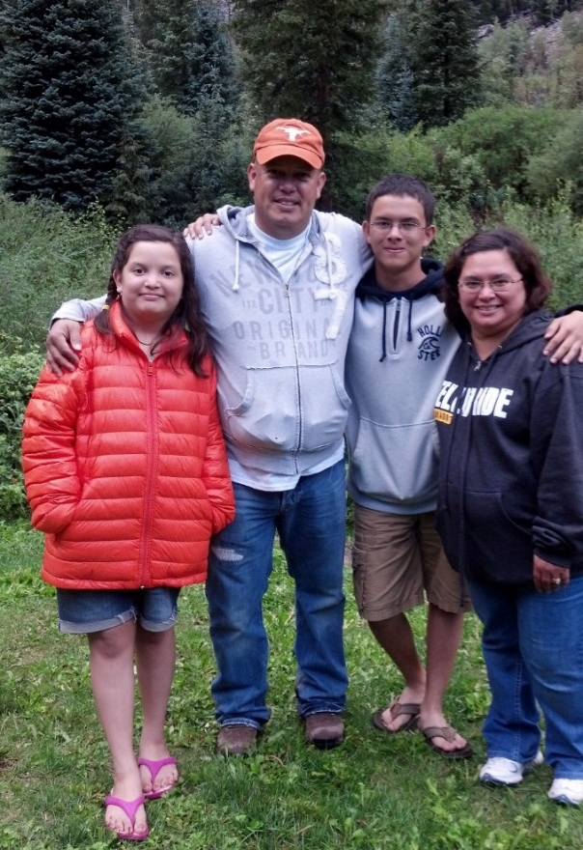
Awareness Campaign
The VA is counting on the Elks network to spread the word about veteran homelessness, and how we can end it. Be a local advocate!
Talk about the issue.
Encourage business owners to hire veterans.
Help find affordable housing for veterans.
Talk to local landlords about the benefits of renting to a veteran.
Notes:
Talk about the issue of veteran homelessness, and how the Elks are helping. Encourage your friends, neighbors and family members to get involved. People want to help. Tell them how!

Slide 11
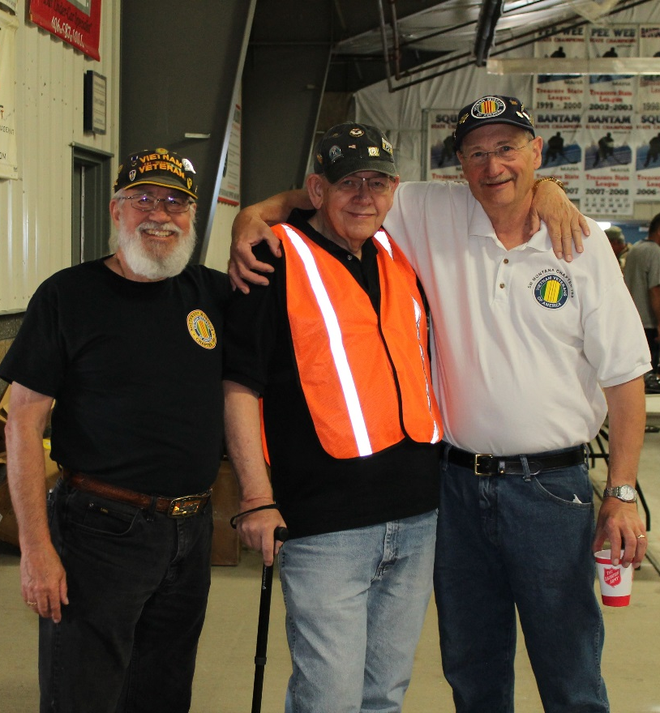
Elks Housing Navigators
Elks members interested in providing 10-15 hours of service a month at VA facilities can sign up to be Elks Housing Navigators.
These volunteers will act as mentors and friends to help homeless veterans tackle their challenges, find a home and become integrated into the community.
Similar to VAVS Reps, training and support will be provided by the local VA and by the ENVSC.
Partner with HUD-VASH program
Interested in being a Housing Navigator? Contact the ENVSC and we’ll put you in contact with the homeless services coordinator in your area.
Notes:
Duties may include helping veterans search for affordable apartments, helping veterans find jobs, assisting veterans with moving and setting up their home. Many veterans who have been chronically homeless have an extra need for support. Elks can do things like gather simple meal ideas, teach home maintenance tips, and assist in communication with landlords.
For example, I recently heard a story about a VA social worker who visited a veteran not long after they moved in. When they walked in, the house was 100 degrees. It turns out the vet couldn’t figure out how to fix the thermostat and didn’t know have anyone to call who might be able to help. They’d been living in the heat for days.

Slide 12
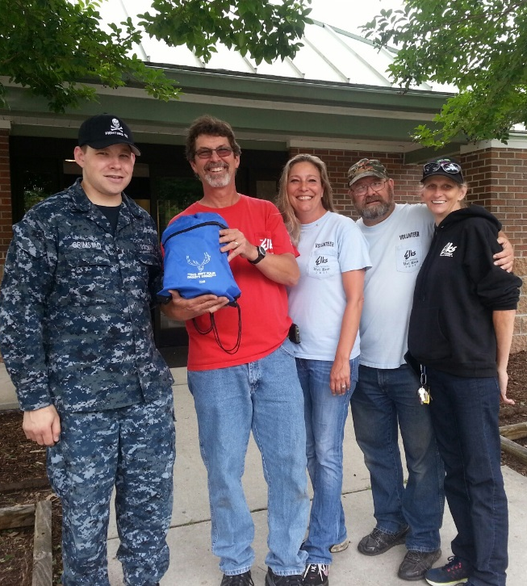
Welcome Home Kits
Most formerly homeless veterans move into their homes with nothing. Elks can help by building Welcome Home Kits.
Gather things like sheets, towels, dishes and cleaning supplies. Items can be new or used, donated or purchased.
Hold a supply drive in the community to collect common items.
Partner with local veterans homes/centers, or contact the ENVSC to be put in touch with veterans in need of kits at your local VA.
Submit your receipts and the ENVSC will reimburse your Lodge up to $200 for each Welcome Home Kit you donate.
Notes:
This form is available online at www.elks.org/vets/welcomehome.cfm. Elks can submit one or several applications at once.

Slide 13
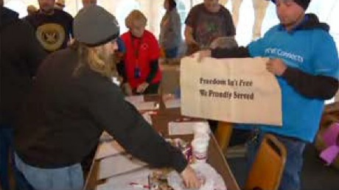
Adopt-a-Vet
The Adopt-a-Vet program can be adapted to serve homeless veterans.
Once a veteran is home, it can be difficult to change habits and transition from a life on the street. Veterans may need assistance with independent living and skills like budgeting and cleaning.
Efforts should be focused on helping veterans become independent and integrated into the community.
Notes:
Living alone in a new home can be much different than living in shelters or staying with friends. Veterans may be in a new community (wherever affordable housing can be found) and need help getting to know people. And, veterans may need a local support network. The Elks can be this for veterans in need.
You can get started by visiting homeless shelters, veterans transitional centers, VA community resource and referral centers. You can “adopt” whole facilities and host social events, invite individuals to the Lodge, donate supplies or just be a friend.

Slide 14
Increased Focus on 8 Cities
The VA has asked the Elks to focus their efforts in and around the following 8 cities, which they’ve identified as the areas of highest need.
Two additional programs will be available to Lodges in and surrounding these areas.
Chicago New York
Washington, D.C. Los Angeles
Loma Linda San Francisco
Seattle Miami-Dade

Slide 15
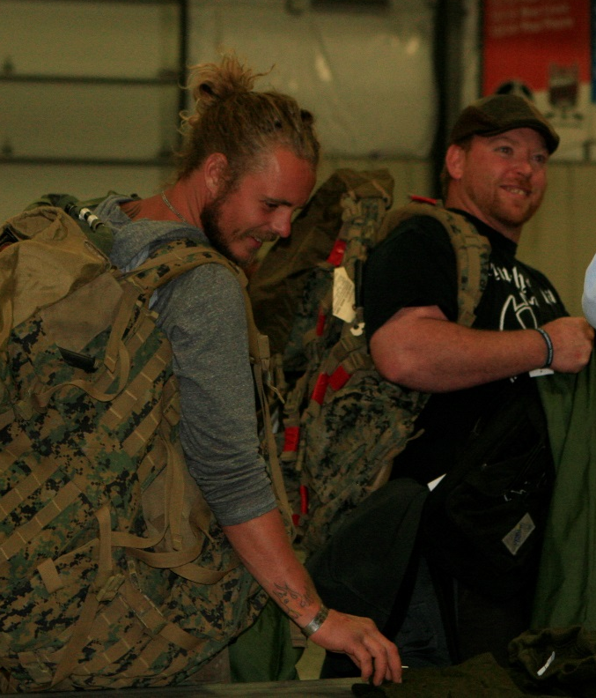
Elks Emergency
Assistance Program
Veterans registered with and receiving services from the Department of Veterans Affairs in these 8 areas can apply for one-time monetary assistance to prevent homelessness or secure a home.
Uses include rent and security deposits, mortgage and utilities.
Forms must be signed by the veteran and by a VA employee.
Intended to help with prevention of homelessness, and to help veterans exit homelessness.
This program is only available in
the following 8 cities:
Chicago New York
Washington, D.C. Los Angeles
Loma Linda San Francisco
Seattle Miami-Dade
Notes:
I don’t know if you saw the video at opening sessions yesterday, but we’ve been able to help nearly 400 veterans through this program already, and the stories are heartwarming. All handled by Elks offices!

Slide 16
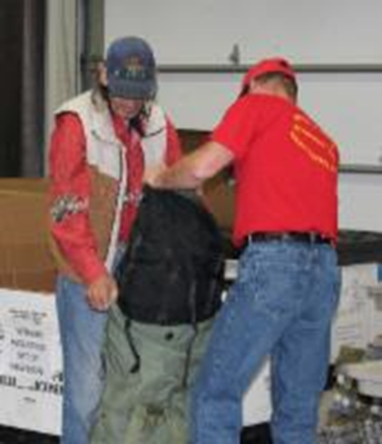
Extra Grant Funding
Select Lodges will be eligible for Welcome Home grants to serve veterans experiencing homelessness.
Applications for these Lodges become available August 1.
Lodges outside these areas are encouraged to use a Freedom Grant (or other Lodge Grants) for this purpose.
This program is only available in
the following 8 cities:
Chicago New York
Washington, D.C. Los Angeles
Loma Linda San Francisco
Seattle Miami-Dade
Notes:
August 1!

Slide 17
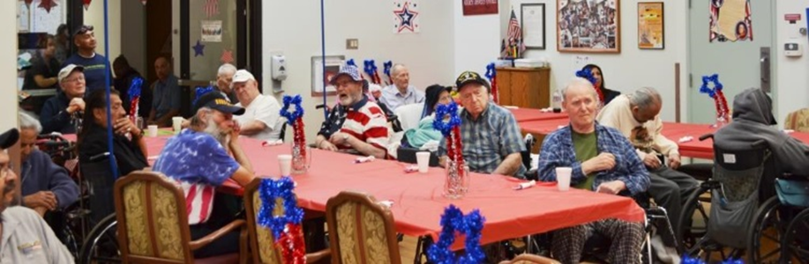
Progress So Far
The Elks Emergency Assistance Program has helped nearly 400 veterans exit or prevent homelessness since 2015.
Lodges have provided Welcome Home Kits for nearly 100 veterans through our reimbursement program.
The Elks are partnering with the city of Chicago to provide a $100,000 emergency fund to provide more than 50 currently homeless veterans with housing.

Slide 18
Stay in Touch!
Visit www.elks.org/vets for more information!
Sign up for our email newsletter at www.elks.org/vets/newsletter.cfm.
Call us at 773-755-4736.
Email us at vets@elks.org.
Visit our Facebook page! Follow us on Twitter!

Slide 19
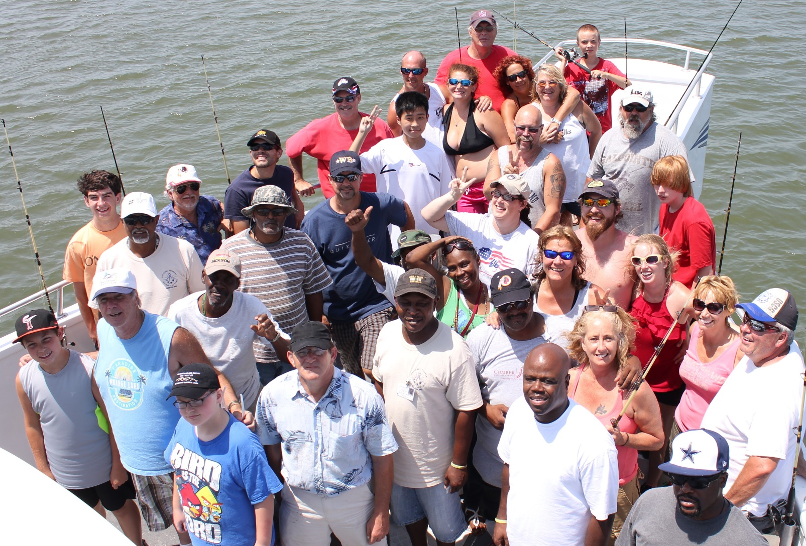
The End
Notes:
Questions?

