Slide 1
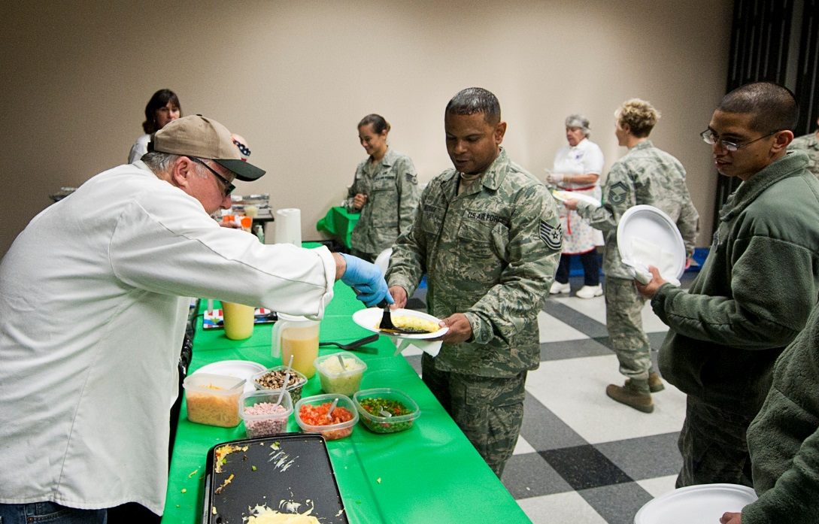
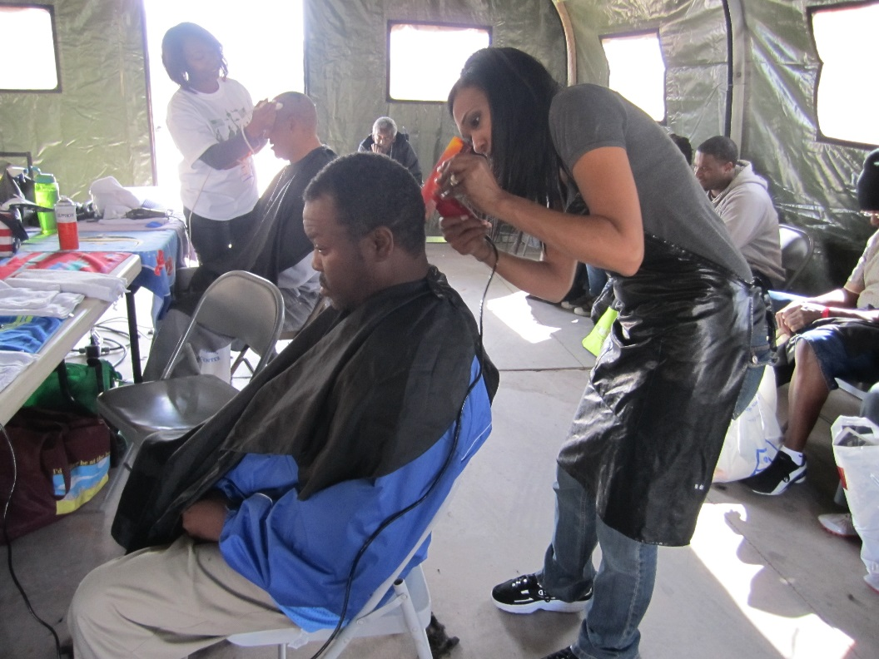
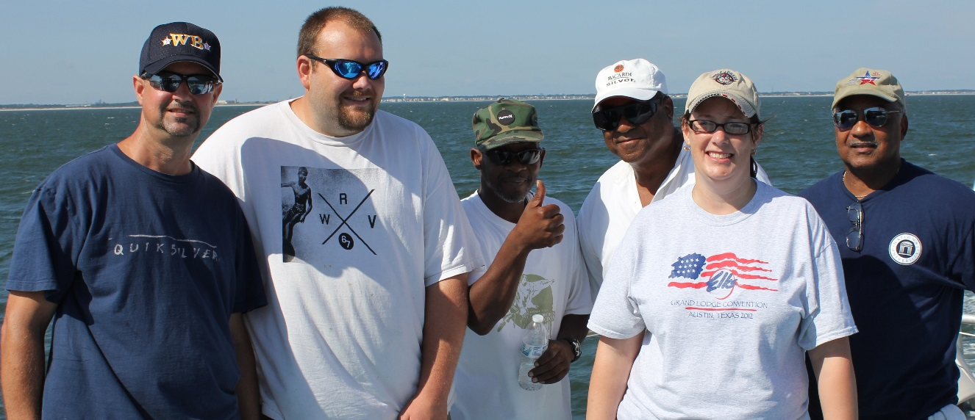
Serving our Nation’s Veterans

Slide 2
Elks National Veterans Service Commission
Ending Veteran Homelessness: How the Elks can Help
Elks National Convention
July 4, 2016

Slide 3
Our Mission
The Elks are committed to the mission, “So long as there are veterans, the Benevolent and Protective Order of Elks will never forget them.”
The Veterans Service Commission takes that pledge one step further, and promises service to our nation's veterans and military members, with a special focus on service to those in need.

Slide 4
ENVSC Programs
National Programs
Freedom Grants
Playing Cards for
Vets
VAVS
Veterans Leather
Program
Adopt-a-Vet
Welcome Home
Partnerships
Re-Creation
Bugles Across
America
VA Adaptive Sports Events
Notes:
Today, we’ll be focusing mostly on the newest program, the Welcome Home program.

Slide 5
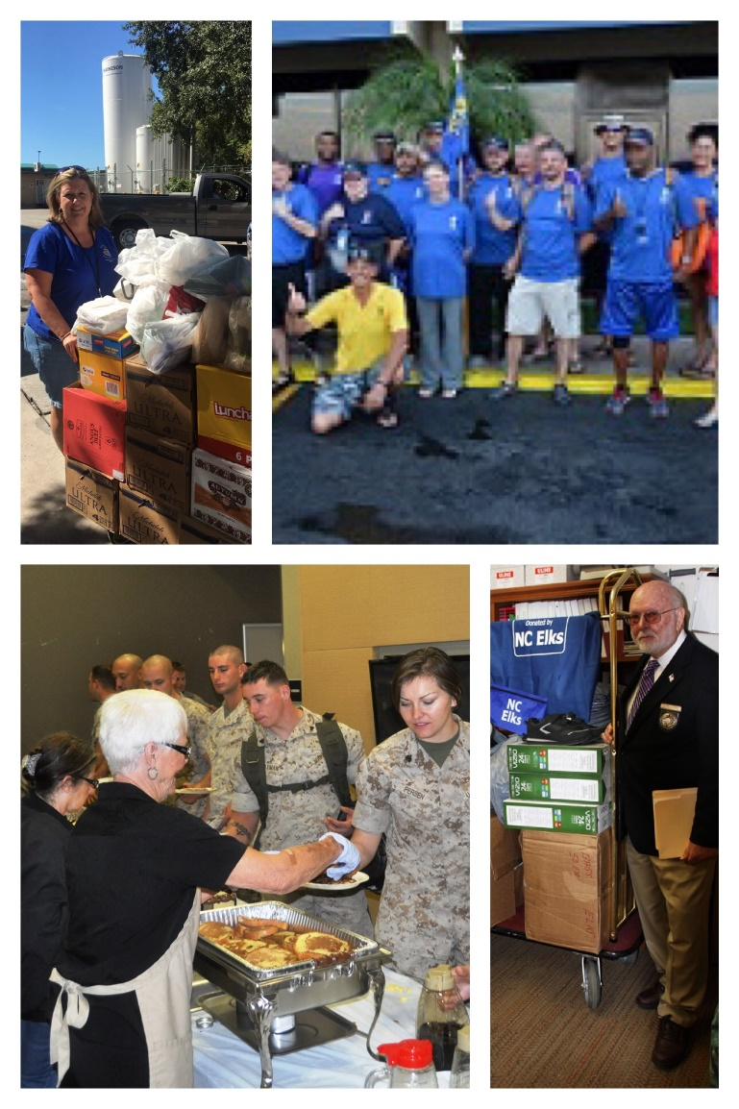
Additional Guidelines
In recent years, the Commission has affirmed that the focus of our programs at the national level should be on direct service military members and veterans in need.
Unfortunately, there are many veterans/military members in need.
This does not mean that projects like veterans memorials and ceremonies honoring the fallen are not important. It just means that national ENVSC funds cannot be used to fund them.
We encourage state and local Lodges to fund these on their own if they choose.
This includes memorials at VA facilities and elsewhere.

Slide 6
Today’s Veterans
Projected U.S. Population of Veterans: 21,999,000
9% of U.S. Veterans are female.
45.23% of Veterans are aged 65 or older
Total enrollees in VA care system: 9.11 million
6.6 million Veterans received services from the VA in 2014
54% of veterans surveyed by Blue Star Families reported that their transition from service was difficult.
Notes:
Today’s military is 15% female, and this group is only growing.

Slide 7
The Good, the Bad . . .
The Good News
The VA has made this issue a priority, and provides health care, housing solutions, job training, rent assistance and other supportive services.
They’ve recruited community partners, and raised awareness.
Between 2015 and 2016, veteran homelessness decreased by 17 percent.
Since 2010, there has been a 47 percent decline in veteran homelessness.
The Bad News
There are as man as 40,000 veterans experiencing homelessness in the United States on any given night.
70 percent of veterans served by the VA have dealt with chronic homelessness and unemployment.
14 percent of veterans served by the VA have families.
Many veterans are chronically homeless and/or have co-occurring health issues and substance abuse problems.
Many veterans who become homeless don’t know they can go to the VA for help.
Notes:
What we’ve learned this year is that it’s pretty easy to fall into homelessness. Things like health problems or a car breakdown can cause someone to lose their job, and pretty soon they can’t pay their rent or their mortgage.
Chronically homeless means without a home for more than a year, or experienced homelessness 4 times or more during the last 3 years.

Slide 8
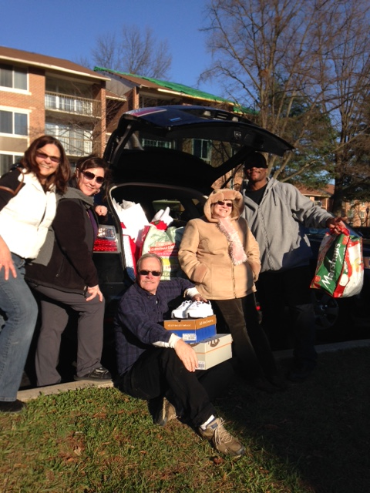
And the Elks.
The VA can’t solve this problem alone. That’s where we step in. In September 2015, the Elks signed a Memorandum of Agreement with the VA pledging to serve homeless veterans. The Elks have pledged $4 million over four years to help end veteran homelessness.
The program has 3 main components:
Welcome Home Kits
Elks Emergency Assistance Program
Welcome Home Grants

Slide 9
Where to Start
The VA: every VA Medical Center has at least one person on staff whose job is to focus on homeless veterans
Many VA facilities have a HUD-VASH department, which employs social workers to serve veterans.
There are 30 VA facilities called CRRCs, which are resource centers and clinics that cater specifically to veterans who are experiencing homelessness.
Nonprofits: national groups like Volunteers of America, Catholic Charities and the Salvation Army have veterans outreach programs and transitional homes.

Slide 10
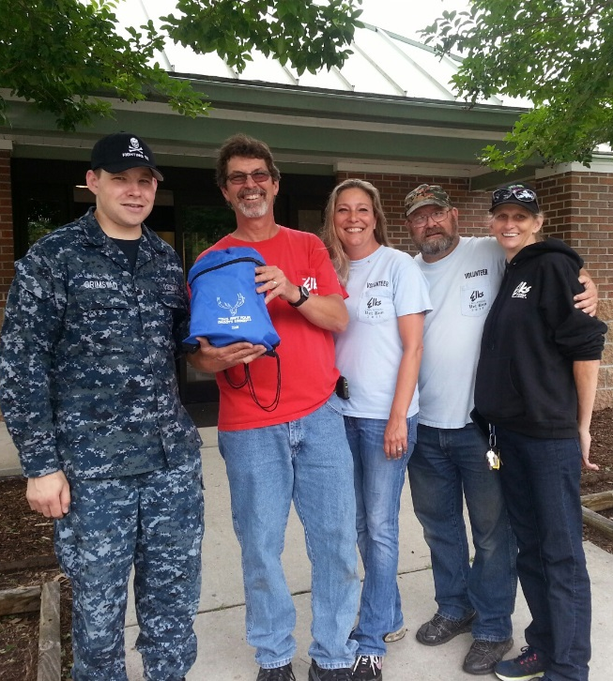
Part 1: Welcome Home Kits
Most formerly homeless veterans move into their homes with nothing. Elks can help by building Welcome Home Kits.
Gather things like sheets, towels, dishes and cleaning supplies. Items can be new or used, donated or purchased.
Hold a supply drive in the community to collect common items.
Partner with local veterans homes/centers, or contact the ENVSC to be put in touch with veterans in need of kits at your local VA.
Submit your receipts and the ENVSC will reimburse your Lodge up to $200 for each Welcome Home Kit you donate.

Slide 11
Check out this video featuring Cocoa Beach Lodge’s outreach program.
“Elks Welcome Home Kits: I couldn’t be prouder to be a part of it.”

Slide 12
Welcome Home: 2 Years In

Slide 13
Part 2: Elks Emergency Assistance Program
Veterans registered with and receiving services from the Department of Veterans Affairs in these 8 areas can apply for one-time monetary assistance to prevent homelessness or secure a home.
Uses include rent and security deposits, mortgage and utilities.
Forms must be signed by the veteran and by a VA employee.
Intended to help with prevention of homelessness, and to help veterans exit homelessness.
Run out of the Chicago ENVSC-office.
This program is only available in the following cities:
Chicago New York Seattle Miami-Dade San Francisco San Diego
Los Angeles / Loma Linda
Washington, D.C.
Notes:
I don’t know if you saw the video at opening sessions yesterday, but we’ve been able to help nearly 400 veterans through this program already, and the stories are heartwarming. All handled by Elks offices!

Slide 14
Watch this video of VA Social Workers raving about the Elks. Check out the background to catch a glimpse of Elks Scholars helping out at the Chicago Winter Stand down!

Slide 15
Welcome Home: 2 Years In
"I am the homeless Vietnam veteran that you gave tremendous assistance. I just wanted to say that I'm extremely thankful for desperately needed aid. I am pleased to inform you that I have signed a lease on an apartment, and I am no longer homeless! Thank you for the Elk's great Veterans Service Commission.
Sincerely thankful, a Proud Vietnam combat Veteran"

Slide 16
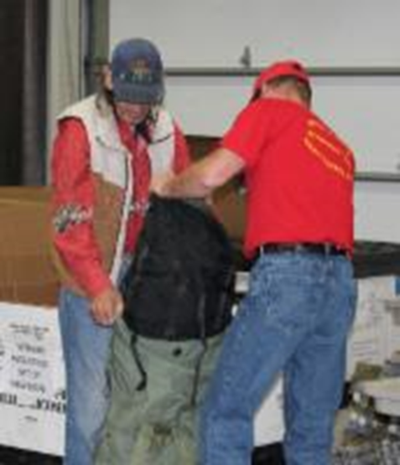
Part 3: Extra Focus on Areas of Greatest Need
Select Lodges are eligible for Welcome Home grants to serve veterans experiencing homelessness.
Applications for these grants available online July 1 to May 31.
These 8 urban areas were chosen by the VA because they have the highest number of homeless veterans.
Lodges outside these areas are encouraged to use other Lodge Grants to serve homeless veterans.
This program is only available in the following cities:
Chicago New York Washington, D.C. Seattle Miami-Dade San Francisco
San Diego Los Angeles/Loma Linda

Slide 17
Welcome Home: 2 Years In

Slide 18
Volunteer Outreach
Volunteers are our greatest asset! Our goal is to provide Elks with the information, tools and resources they need to stay engaged and take action.
Visit www.elks.org/vets for the latest on all our programs.
While there, sign up to get our monthly e-newsletter. (Lodge Veterans Chairs and VAVS Reps and Deps already receive this.)
The webpage www.elks.org/vets/welcomehome.cfm has all the information you need to get started with this program.
Contact us with any questions, concerns or ideas anytime! You can email us at Vets@elks.org or call us at 773-755-4736.
Follow us on social media!
Facebook/com/ENVSC @ElksVetsService @ElksVets

Slide 19
The End
Notes:
Questions?

